Slide 1
International day of family remittances
Student: Justo David Pedraza Esquerre
Teacher: Vladimir Solano Gonzales

Slide 2
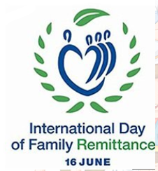
Today, I am going to talk about the international day of family remittances.
First, I would like to explain that family remittances are an income that helps to solve the needs of education, health and food.
Next, I want to mention that this money can be used to improve homes and businesses of the town.
Finally, I will conclude by saying that Mexico is positioned as the country with the most family remittances in Latin America.

