Slide 1
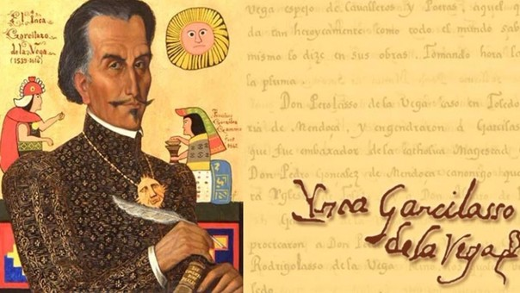
By: Saihaj Singh Laure.

Slide 2
Writer, Poet and Military
His real name was Gómez Suárez de Figueroa, also called EL INCA, he was born in Cuzco, Peru, in 12th of april 1539
His father was Spanish captain and conquistador Sebastián Garcilaso de la Vega y Vargas . His mother was an elite Inca woman, Palla Chimpu Ocllo granddaughter of the powerful Inca Tupac Yupanqui

Slide 3
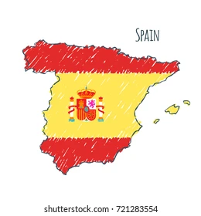
When his father died, El Inca reached Spain in 1561
soon traveled to Madrid
to seek official acknowledgement as his father's son from the Crown, and he was allowed to take the name of Garcilaso de la Vega.
he met his father's brother, Alonso de Vargas, who acted as the young man's protector and helped him make his way

Slide 4
His first book was La Florida del Inca, an account of Hernando de Soto's expedition and journey in Florida. The work was published in Lisbon in 1605 and became popular. It describes the expedition according to its own records and information Garcilaso gathered during the years.
While in Spain, Garcilaso wrote his best-known work, Comentarios Reales de los Incas, published in Lisbon in 1609. It was based mostly on stories and oral histories told him by his Inca relatives when he was a child in Cusco

Slide 5
he died in Cordoba on 23th April 1616

