Slide 1
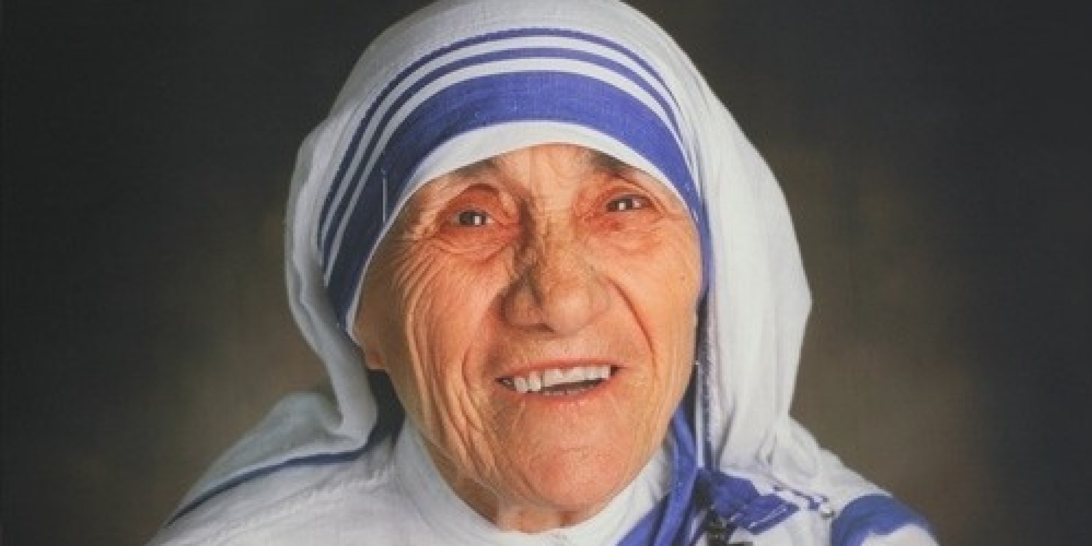
Date: Tuesday seventeen(17) of October 2023
Student: Jorge Cornejo Carrizales
Grade: 2sec. “A”

Slide 2
Good morning teachers and classmates, today I am going to talk to you about the awarding of Mother Teresa of Calcutta. First I would like to explain Mother Teresa of Clacuta was born on August 26, 1910. Next I want to mention At an early age she decided that she was destined for religious life and changed her name to “Teresa”, in reference to the Patron Saint. of the missionaries. In 1950 she founded the congregation of the Missionaries of Charity, and she dedicated herself, for more than 45 years, to caring for the poor, sick, orphans and dying. Finally I will conclude by saying In her Nobel Prize speech, Mother Teresa thanked God “for the gift of peace.”

