Slide 1
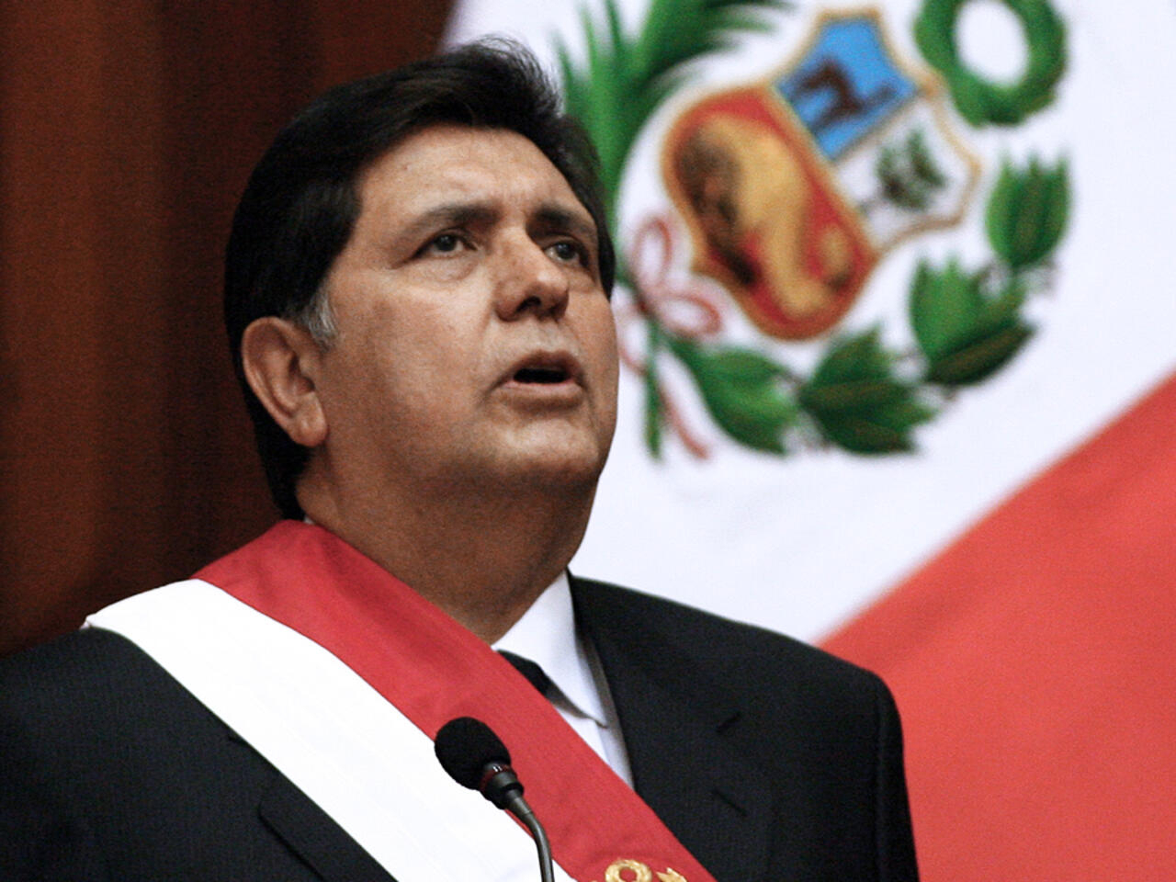
ALAN GARCIA
(THE FORMER PERUVIAN PRESIDENT WHO FLED FROM ALL THE ACCUSATIONS)
BY: SEBASTIAN TAPIA BARRENO

Slide 2
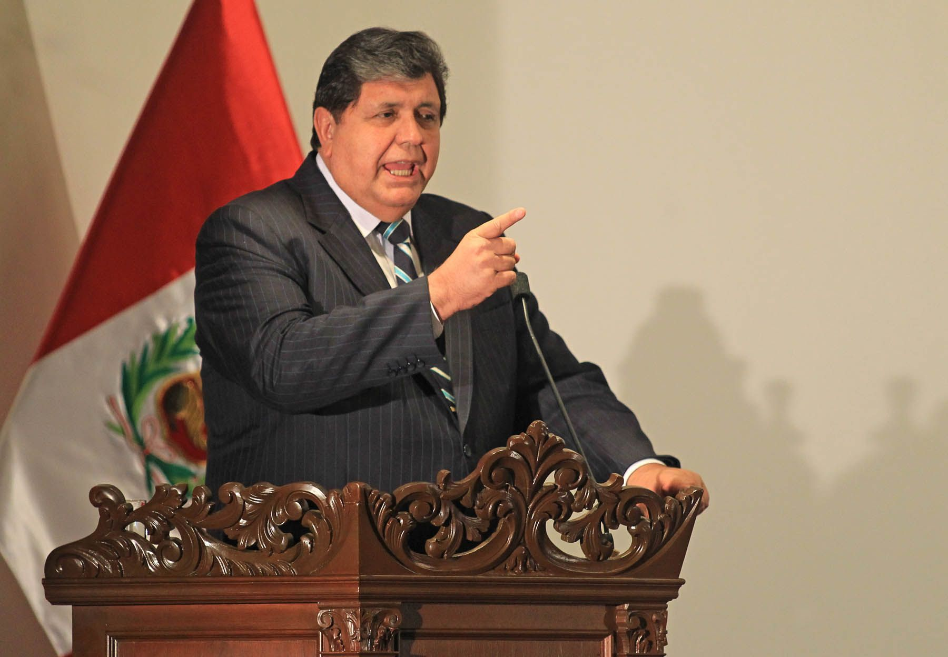
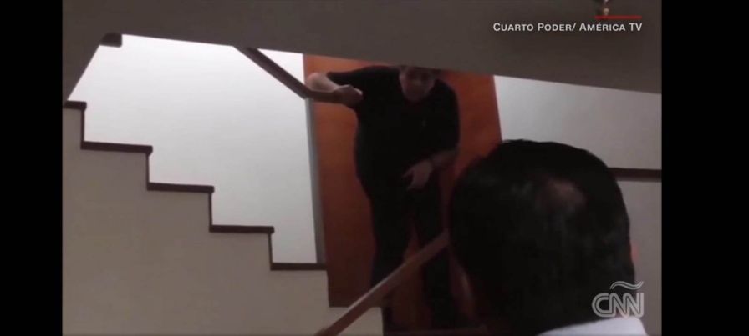
The former president of Peru Alan Garcia Pérez took his own life on April 17, 2019, because he was accused of being involved in corruption cases
This image shows moments that Alan will take his own life

