Slide 1
The Amazing Spider-Man
BY: SEBASTIAN TAPIA BARRENO

Slide 2
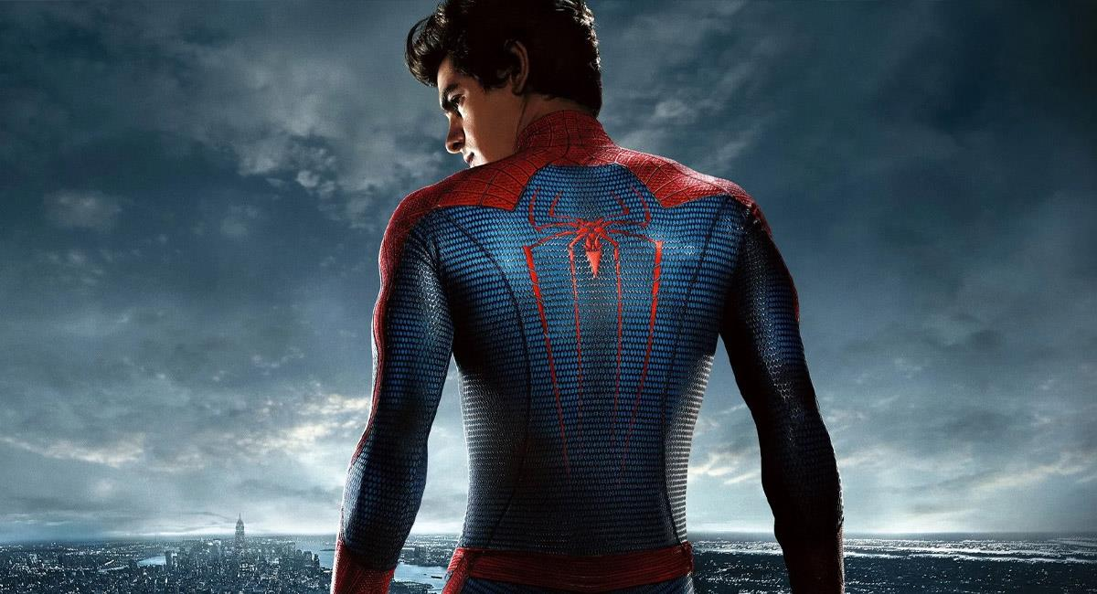
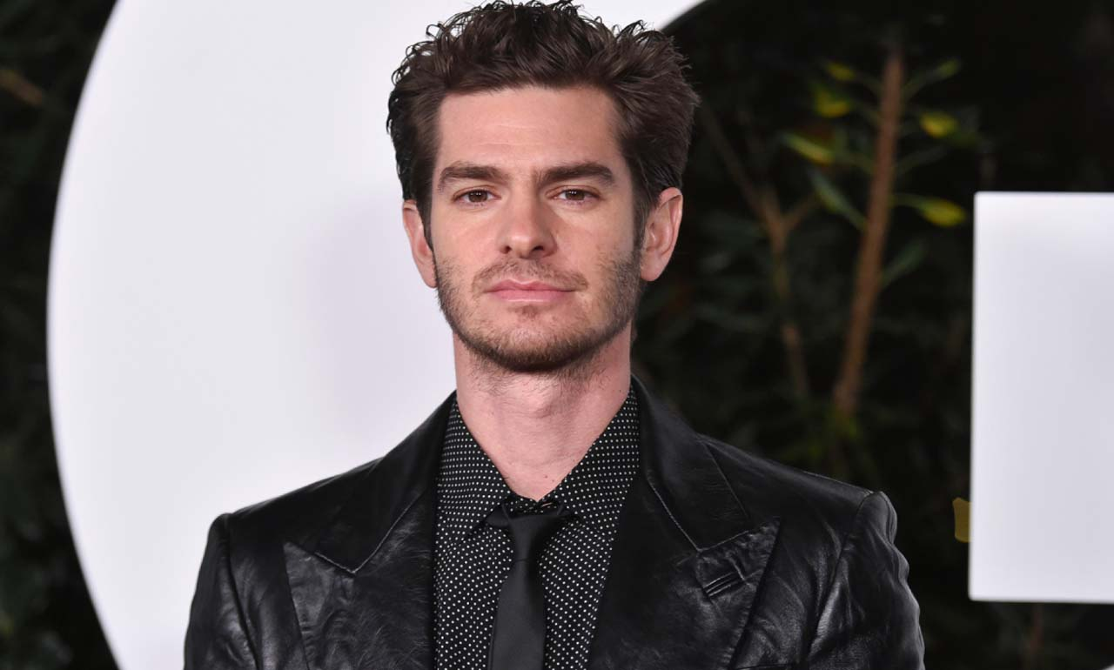
The Amazing Spiderman was released on July 3, 2012 by Andrew Garfield with the production of Columbia Pictures with Marvel Entertainment.
This film had a budget of 220 million dollars and collected 758 million dollars.
My opinion about this movie is that it is one of the best movies in the Spider-Man saga.
ANDREW GARFIELD

