Slide 1
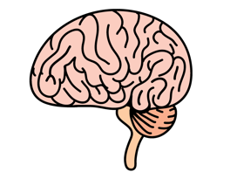
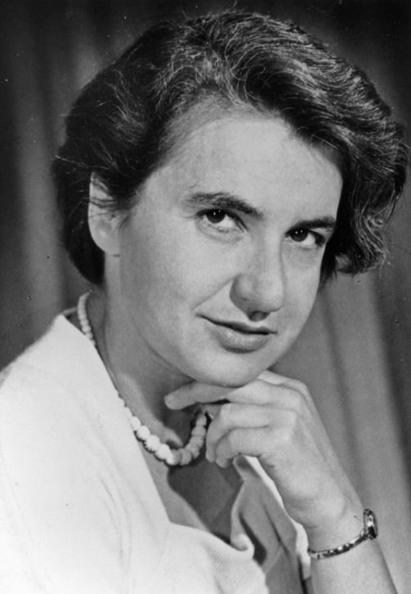
the birth of Rosalind franklin
25TH OF JULY 1920

Slide 2
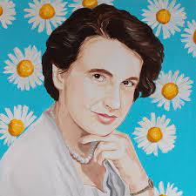
¿Who was Rosalind Franklin?
She was a scientist who dedicated her life to the science of viruses, organisms, etc.
She was born in Nothing Hill, Londres, where she lived with her father.

Slide 3
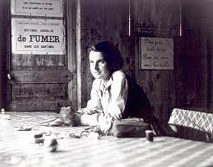
LOGROS
He was studied in Cambridge University.
Country’s war effort.
Reputed crystallographer after long experiences.
Unknown structure of ADN.

Slide 4
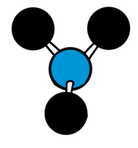
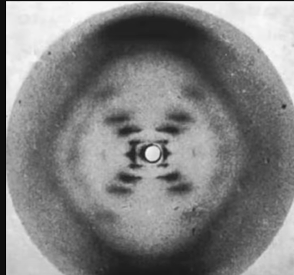
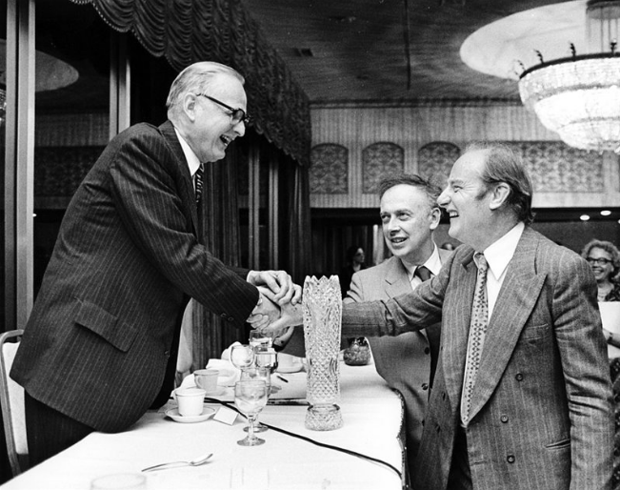
¿Forgotten heroine?
I tell them a story…..

Slide 5
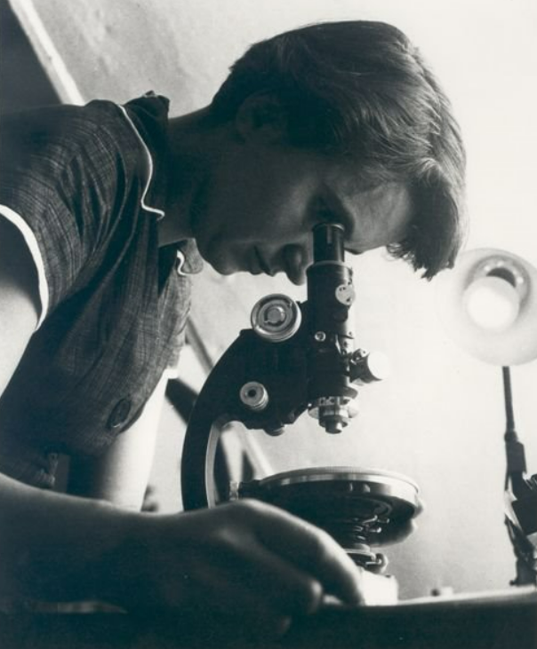
DEATH OF ROSALIND FRANLIKN
Rosalind Franklin suffered from ovarian cancer and died on April 16, 1958.

