Slide 1
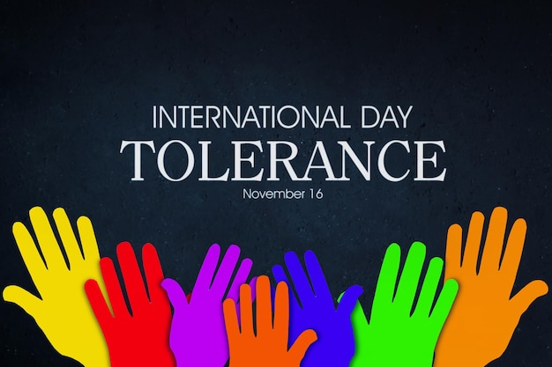
International Day of Tolerance
STUDENT: Walter Fernandez
COURSE: English B2+
TEACHER: Vladimir Solano
DATE: November 16, 2023

Slide 2
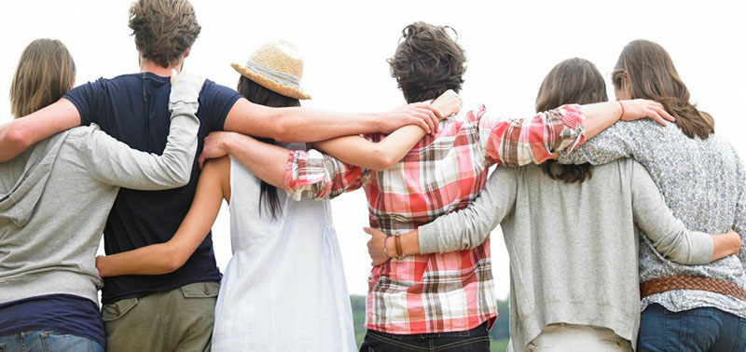
Objectives:
The objective of this day is to promote respect, acceptance and appreciation of cultural, religious and social diversity throughout the world.
Tolerance is a fundamental value in our societies, since it allows us to coexist peacefully and respect the rights and differences of others.
Tolerance Day gives us the opportunity to reflect on the importance of respecting and accepting people regardless of their ethnicity, religion, gender, sexual orientation or other individual characteristics.

Slide 3
wants to teach us:
During this day, different activities and events are carried out to promote tolerance, such as conferences, debates, exhibitions and concerts. In addition, education in values ​​of tolerance is encouraged and we seek to raise people's awareness about the importance of treating others with dignity and respect.
The celebration of Tolerance Day invites us to reflect on our own attitudes and prejudices, and encourages us to build more inclusive and respectful societies. It is a reminder that, despite our differences, we are all human beings and deserve to be treated with equality and dignity.

Slide 4
CONCLUSION:
In short, Tolerance Day is a date to reflect, learn and promote tolerance in our lives and in our communities. It is a call to value and respect diversity, and to work together to build a more just and peaceful world.

