Slide 1
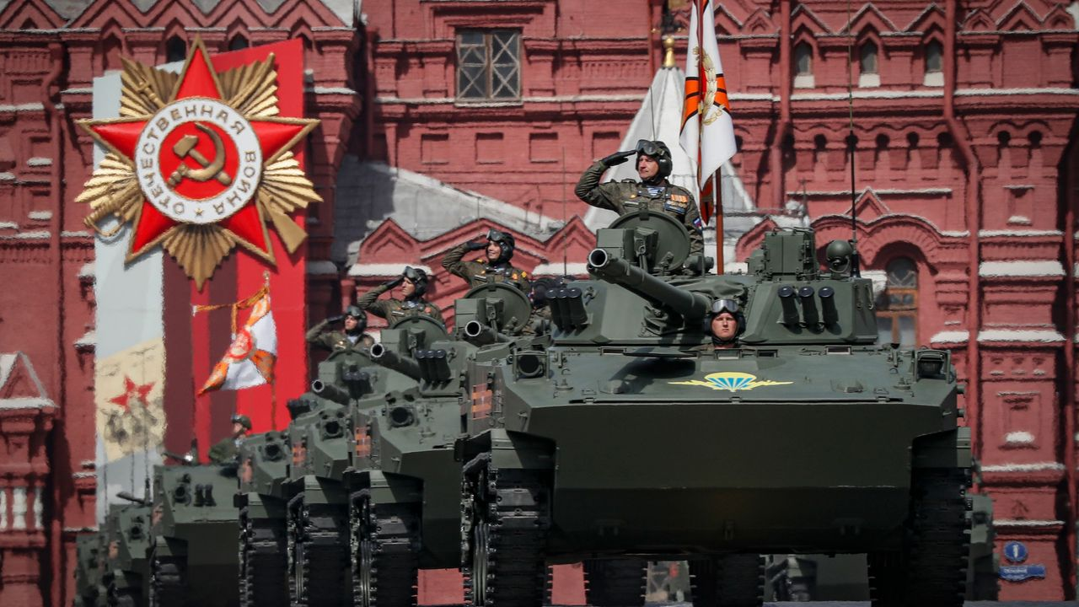
Name and surname : Walter Fabrizio Fernandez Robles Teacher: Vladimir Solano Gonzales Course: INGLÉS B2 Grade and section: 5to B.sec
What day is today?
Victory Day to commemorate the triumph over Nazi Germany in World War II.

Slide 2
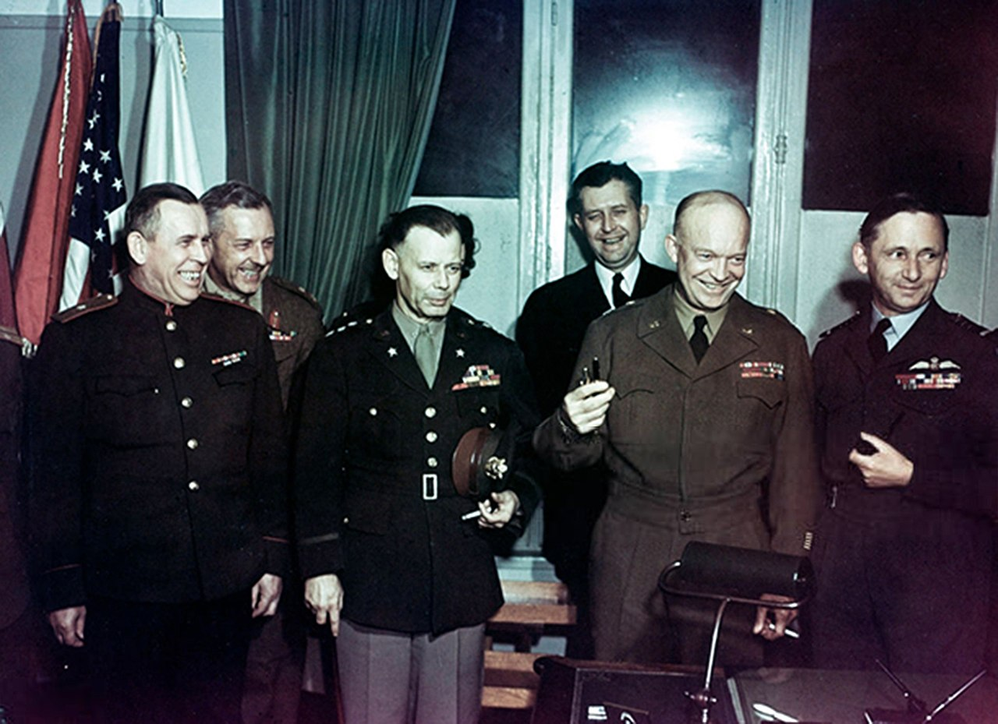
Every May 9, the country commemorates the anniversary of the Soviet Union's victory over Adolf Hitler's Germany in World War II.
This May 9 will mark the 78th anniversary of that feat and Russia will once again celebrate Victory Day.

Slide 3
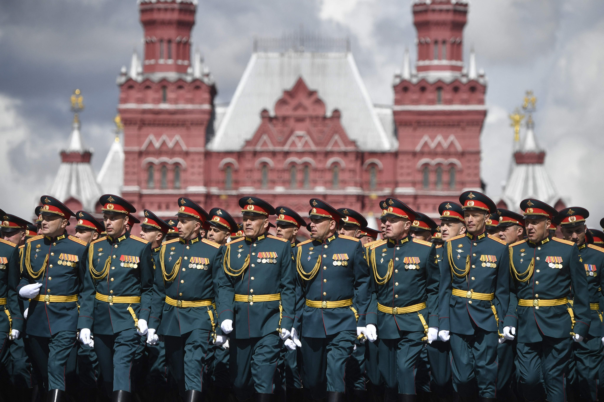
It is a public holiday in Russia, Belarus, and most of the former Soviet republics.
In the case of Russia, military parades continue in front of the Kremlin, also to remember the 27 million Russians who died in that conflict that ended in 1945.

Slide 4
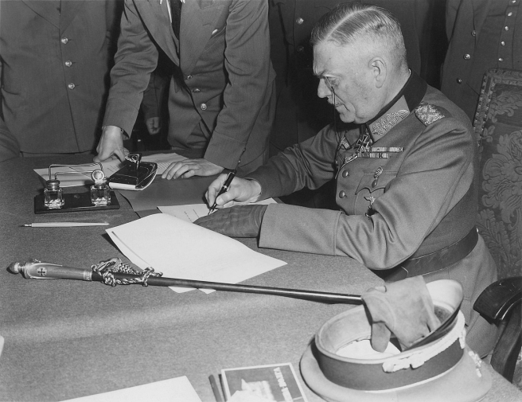
The Nazis signed unconditional surrender on May 8, 1945 at 10:43 p.m. Central European Time, ending the terrible global conflagration on the European continent.
The time difference explains why in Western countries victory is celebrated on May 8 (Victory in Europe Day), while in Eastern Europe it is celebrated on May 9.

