Slide 1
Student: Rodrigo Sánchez
Teacher: Chris Lappin
Subject: English
Date: Monday 15th (Fifteenth) August 2022

Slide 3
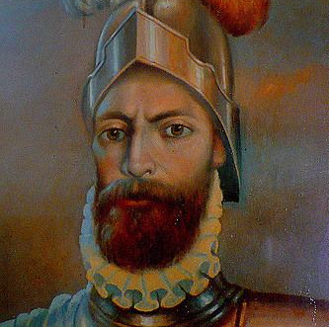
Anniversary of Arequipa
Founded by the Spaniard Garcí Manuel de Carbajal on August 15, 1540
Arequipa celebrates its anniversary each year enthusiastically with festivities throughout the month of August.

Slide 4
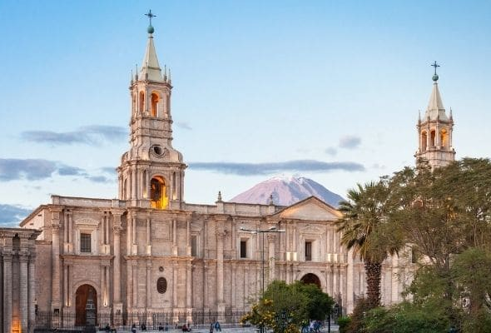
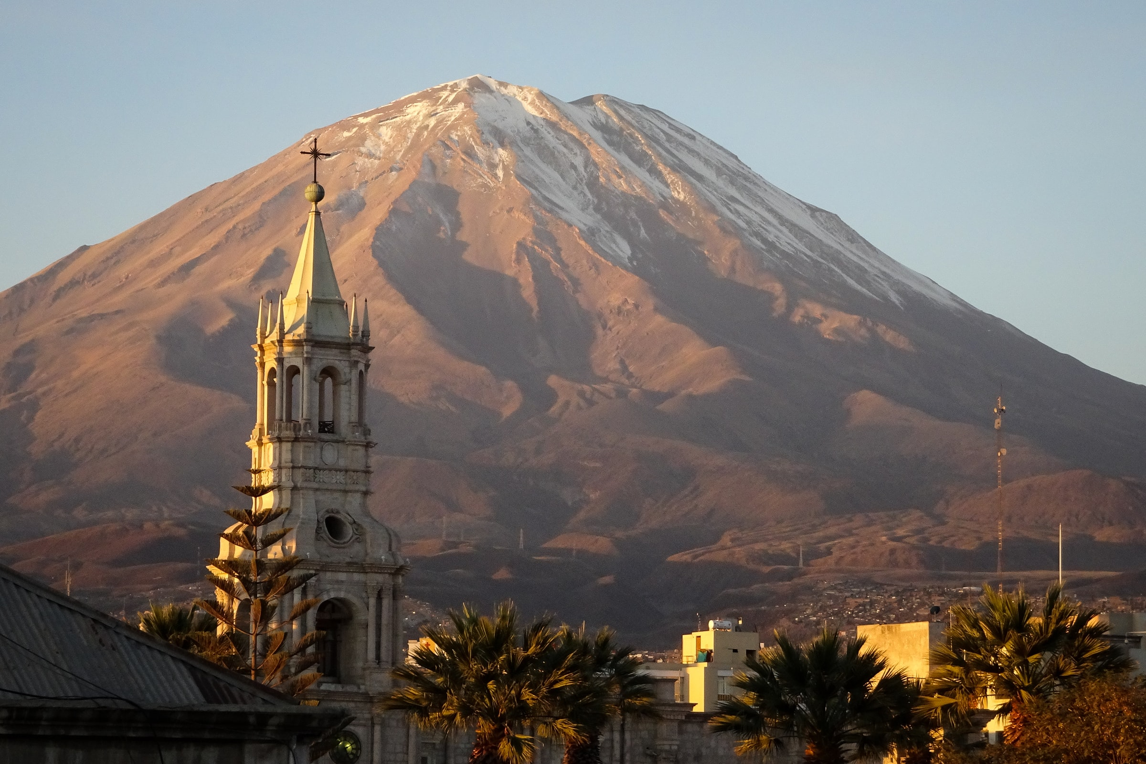
Interesting information

Slide 5
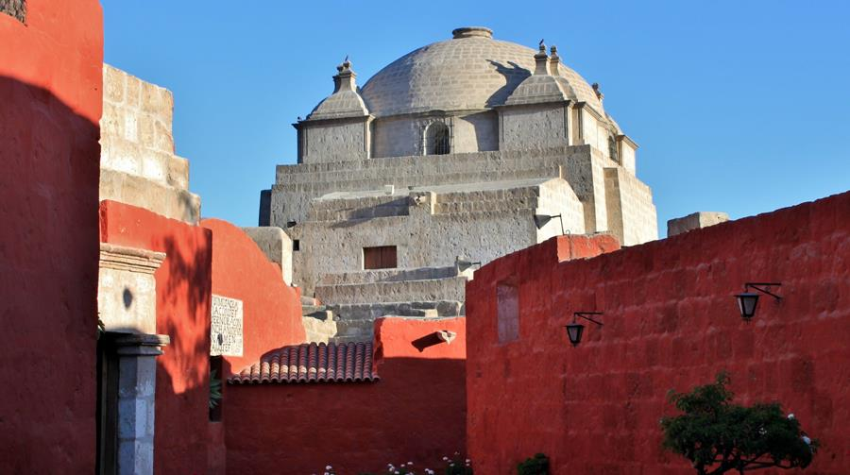
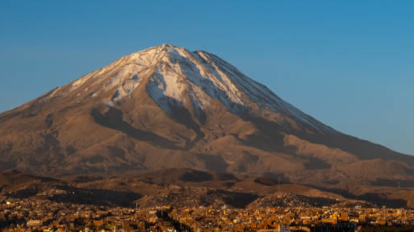
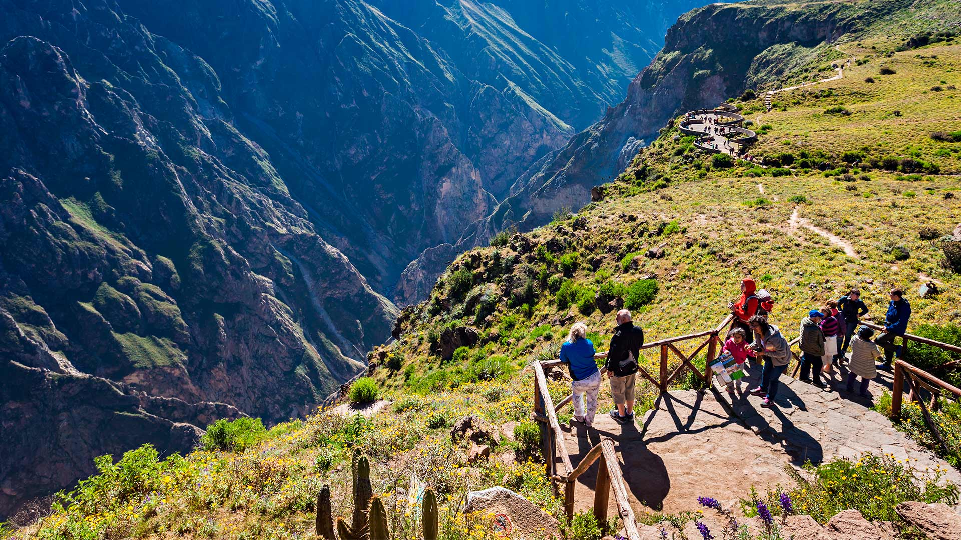
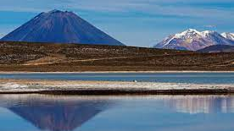
Some places of Arequipa

Slide 6
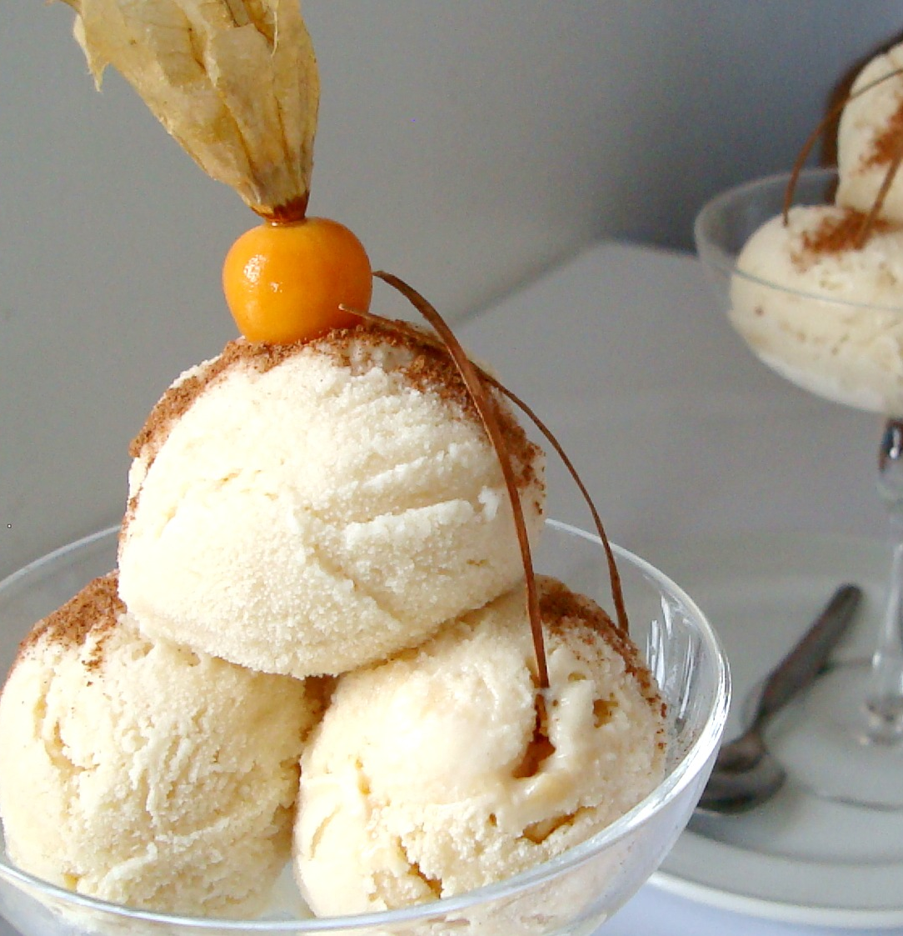
Arequipa’s typical food

