Slide 1
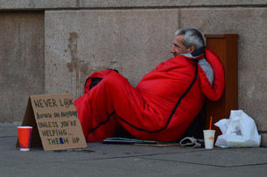
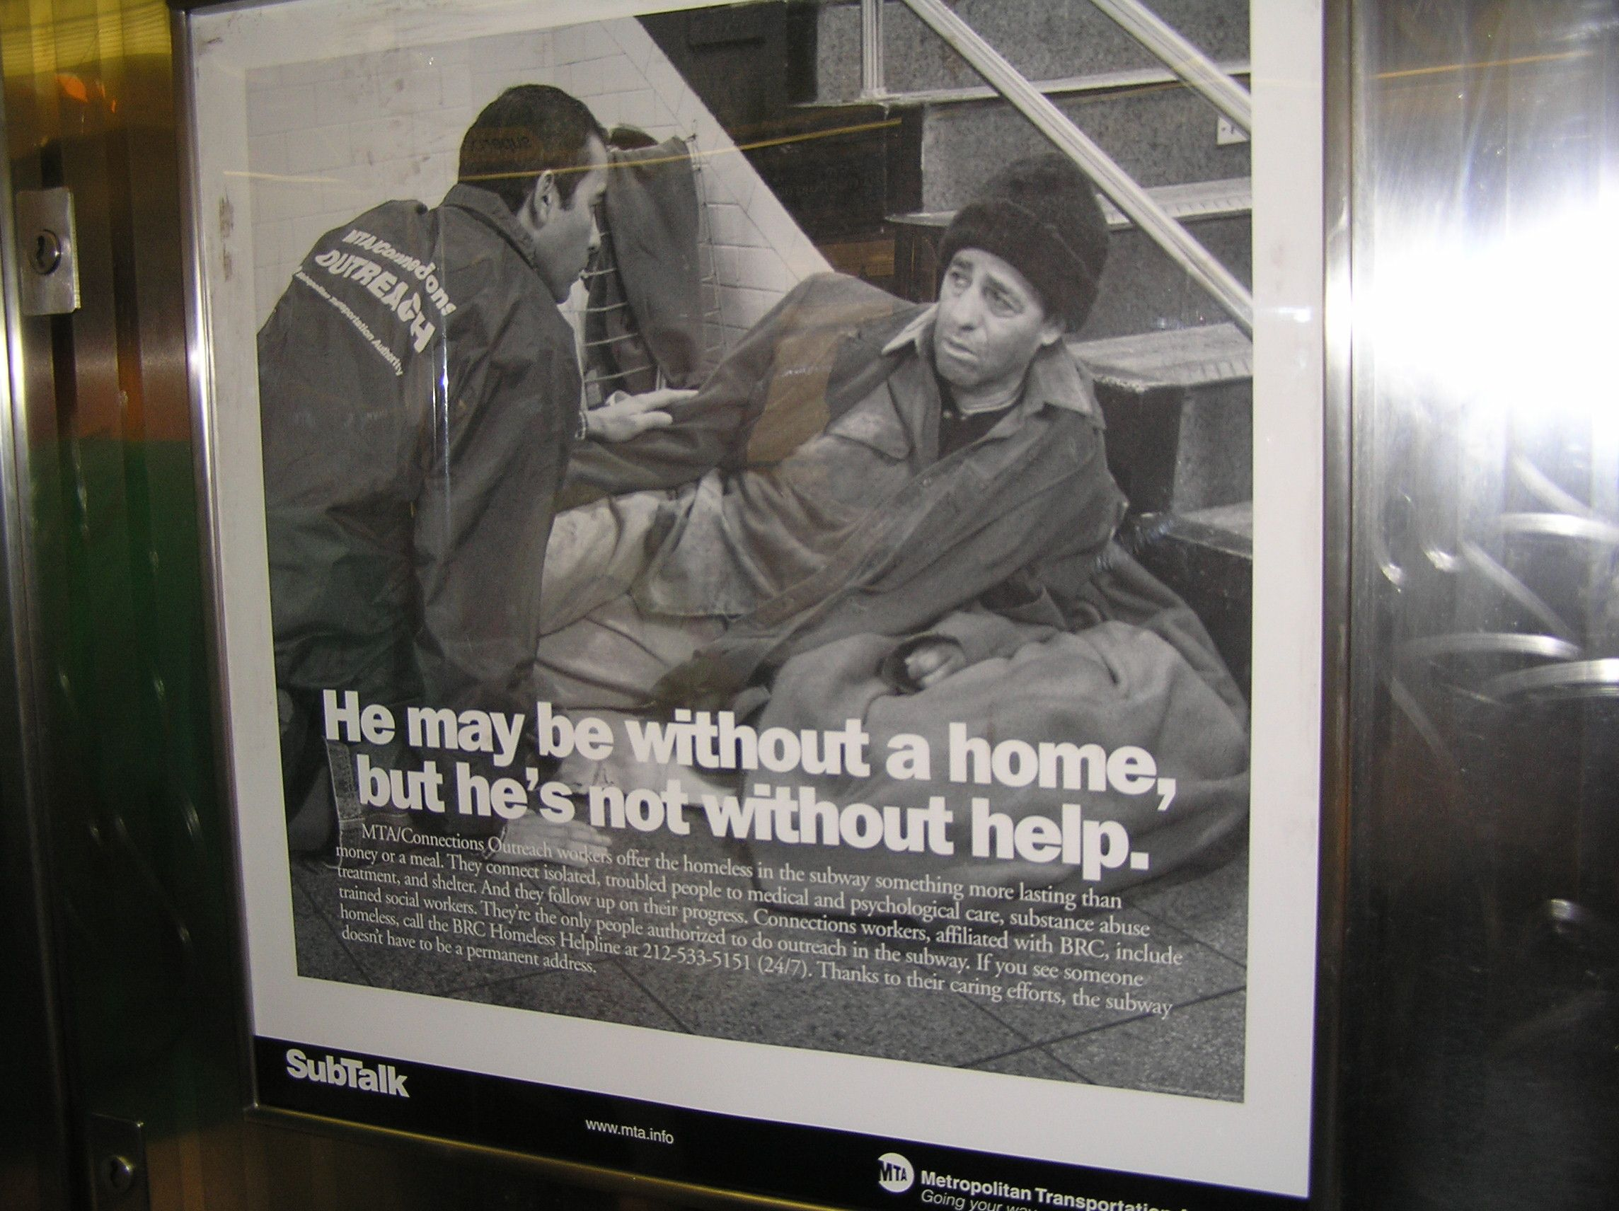
WORLD HOMELESS DAY
World Homeless Day is celebrated every November 28 to remember and honor the homeless, the homeless, those who have lost everything and those of whom we also ignore everything, even that they exist, with the hope that they will not fall into oblivion again.
According to 2018 statistics from the United Nations (UN), it is estimated that currently some 900 million people live in informal settlements or camps, not including people living on the streets.

