Slide 1
A day like today:
2
nd
Of May
By Gabriel Pastor Vásquez

Slide 2
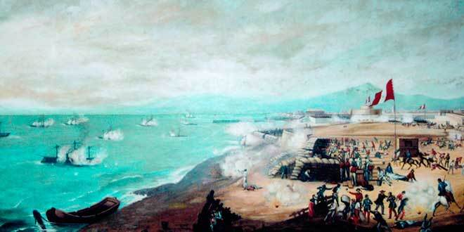
1866
COMBAT OF THE 2ND OF MAY
CALLAO, PERÚ

Slide 3
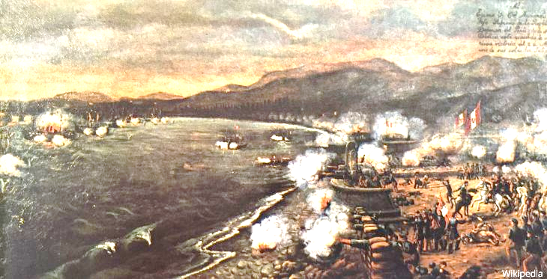
The combat of the 2nd of may also known as Battle of Callao was the last confrontation between Peru and Spain.
In this battle Peru fought for its Independence because Spain hadn´t recognize it.
The Military fought with the help of civilians.

Slide 4
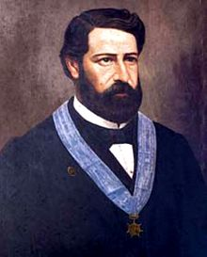
The combat was 8 hours long and finished by 5:00 pm.
José Gálvez was the coronel in charge of the peruvian army and died as a hero with 40 other man.
Peru won the battle when Spain went back to Isla San Lorenzo and never came back.
JOSÉ GÁLVEZ

Slide 5
THANK
YOU

