Slide 1
Teacher: Chris Lappin Student: Rodrigo Sánchez Date: 26th September 2022 Subject: English

Slide 3
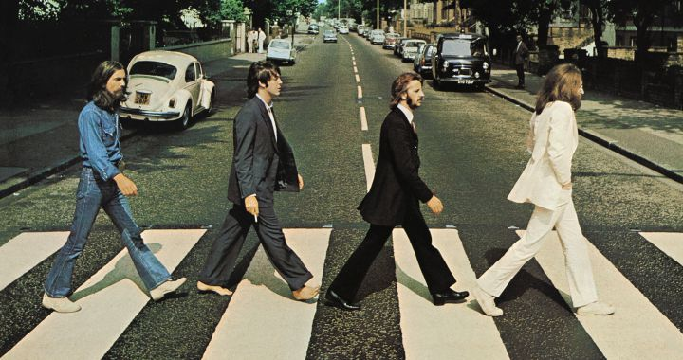
Apple Records releases The Beatles 11th studio album "Abbey Road", their final recordings as a quartet.

Slide 4
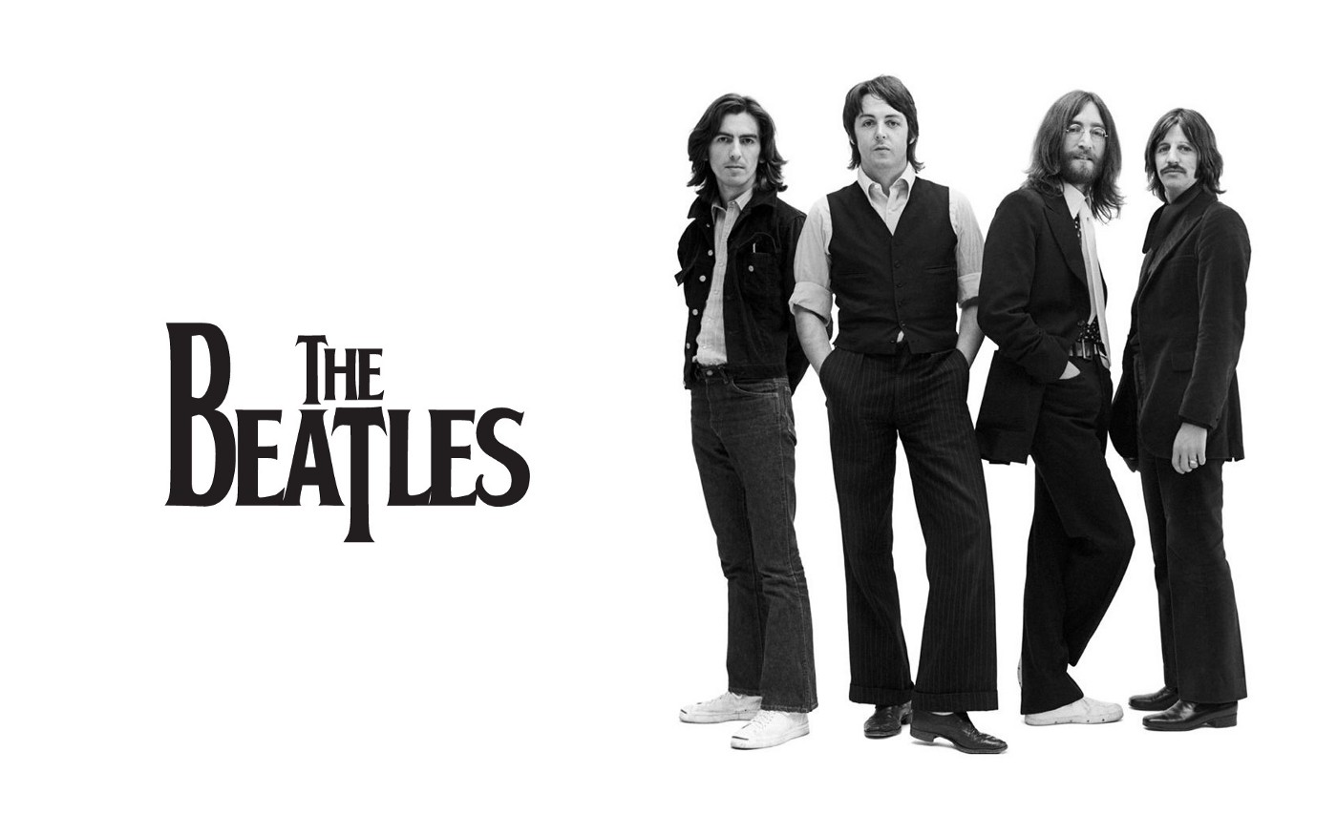
The England band was founded in 1956.
The members were: Paul McCartney, John Lennon, George Harrison and Ringo Starr.
My five favourite songs of The Beatles are: “Hey Jude”, “Let It Be”, “Yesterday”, “She Loves You” and “Don’t Let Me Down”.

Slide 5
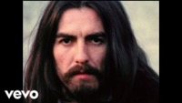
My favourite song of Abbey Road: “Something”
Written by George Harrison.
Recorded in 1968.
The song is about the singer's affection for his beloved, and the great confidence that exists in the relationship.

Slide 6
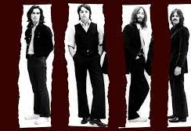
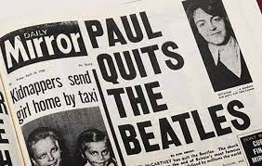
Break-up of the Beatles in 1970
One of the causes was the death of Brian Epstein, the band’s representant, as known as the “fifth Beatle”.
This happened in 10th April 1970.

