Slide 1
Today’s the day
First woman to be elected to US Congress

Slide 2
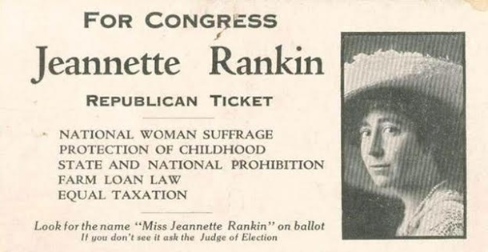
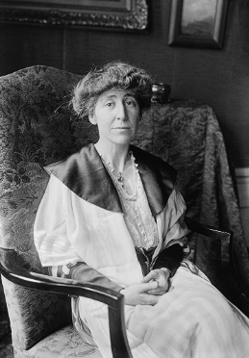
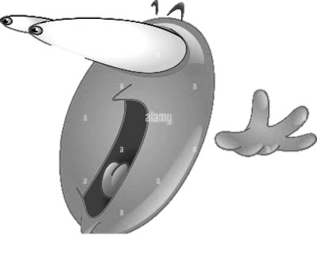
A day like today…
First I want to say that Jeannette Pickering Rankin was an American politician who was born on June 11th of 1880.
Next I want to say She was the first woman to hold federal office in the United States.
She was elected to the U.S. House of Representatives as a Republican from Montana in 1916 for one term, then was elected again in 1940.
Finally I want to say that she was very important because she was the sole member of Congress to vote against the declaration of war on Japan following the attack on Pearl Harbor.

Slide 3
THANKS FOR YOUR ATTENTION

