Slide 1
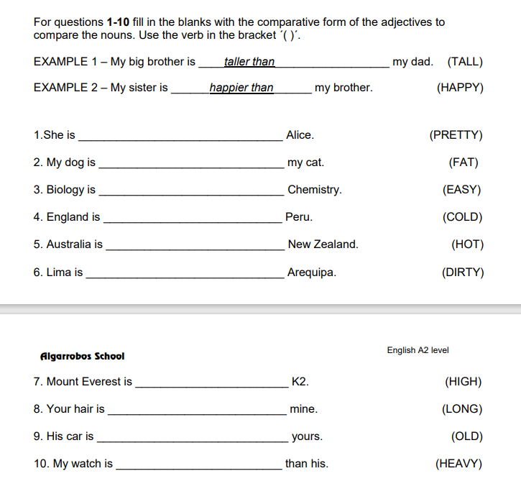
Prettier than
Fatter than
Easier than
Colder than
Hotter than
Dirtier than
higher than
Longer than
Older than
Heavier than

Slide 2
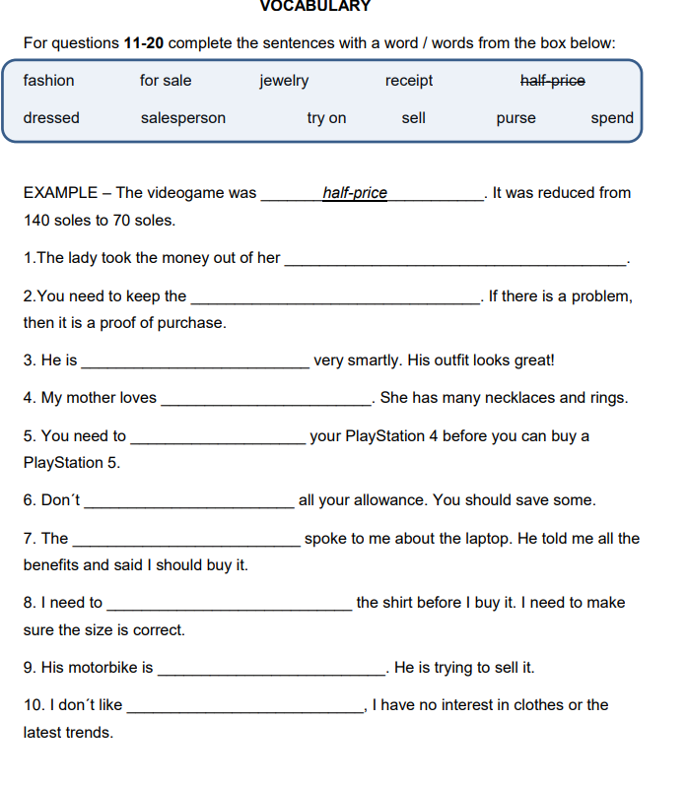
Fashions
spend
dressed
jewelry
purse
salesperson
receipt
try on
for sale
sell

