Slide 1
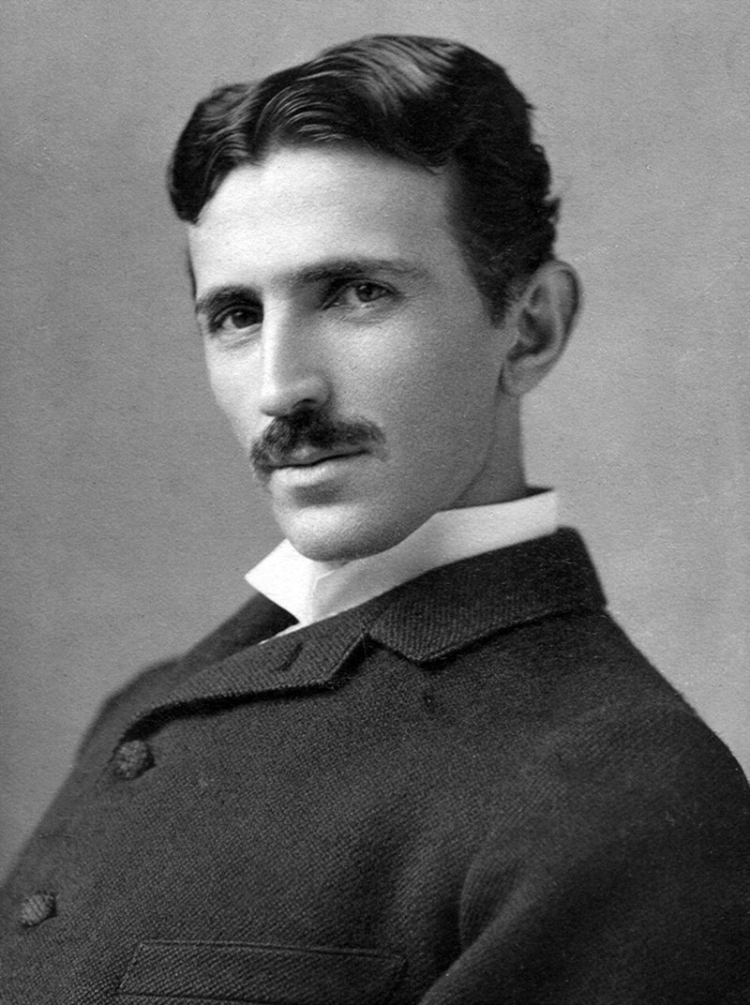
What happened on july 10th?
On july 10th we commemorate the born of Nikola Tesla, a inventor, electrical engineer and physicist born in Serbia in 1856. He is known for his pioneering contributions to the field of electricity and electromagnetism.
He created some things that we use in our ordinary life as the remote control

