Slide 1
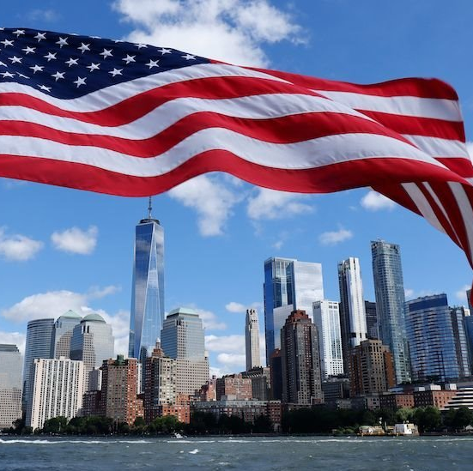
Flag Day in the United States.
Good morning everyone, today I am going to talk about the day of the United States flag, first I would like to explain why it is celebrated on June 14, the day of the United States flag is celebrated on June 14 in commemoration of the legislation of the flag, Next, I want to mention what the design of the flag represents. The 13 red and white stripes represent the 13 original colonies and the 50 stars represent the current 50 states.
Finally, I will conclude by saying on May 30, 1916, President Woodrow Wilson issued a presidential proclamation establishing National Flag Day on June 14. Thanks for you listening

