Slide 1
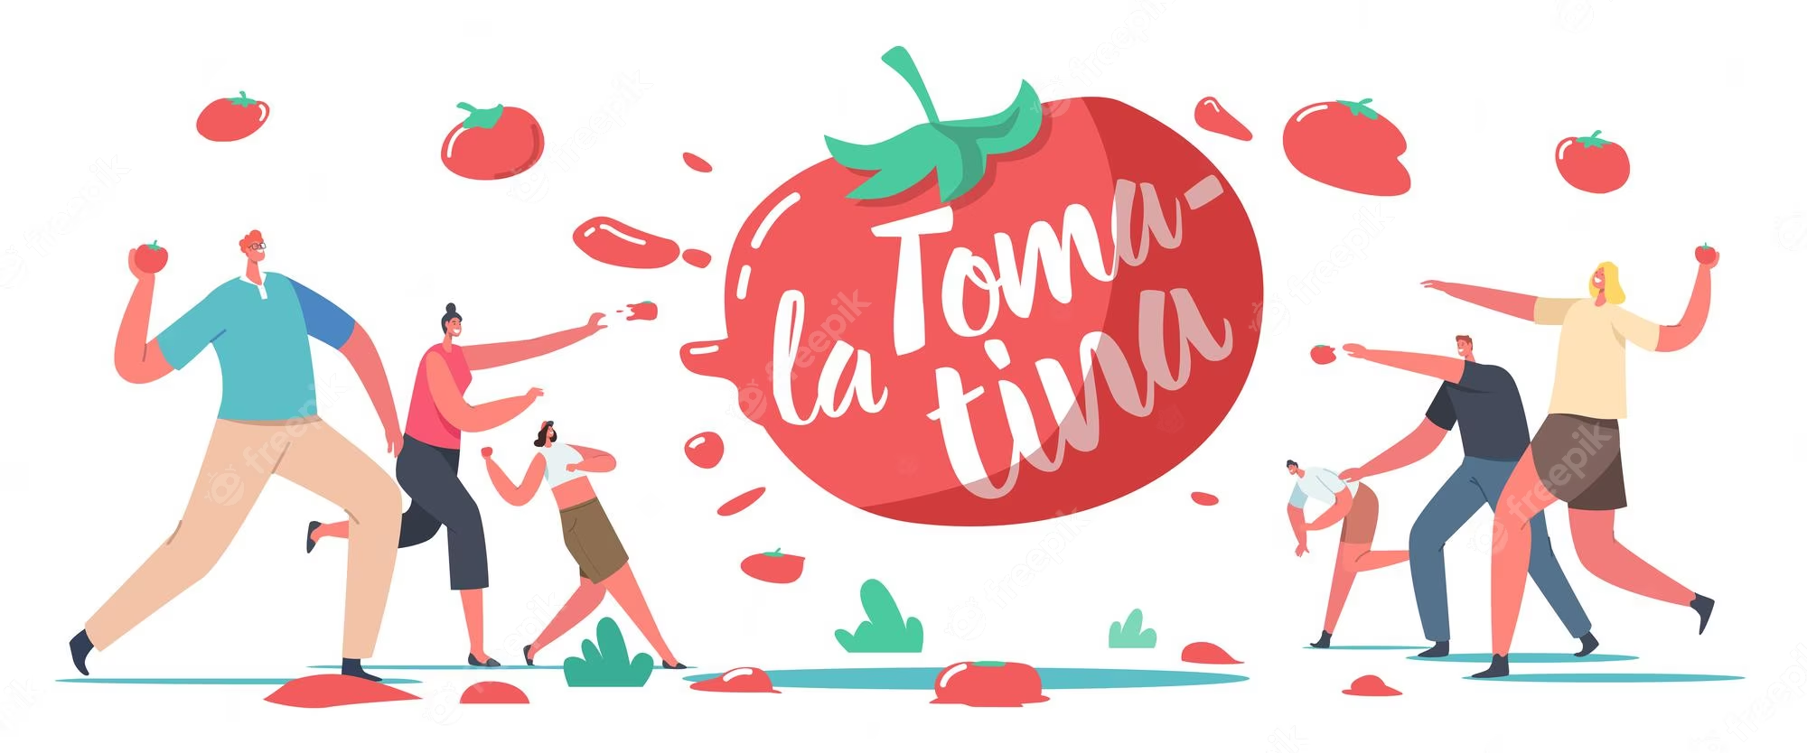
Student: Juan Francisco Muro Barreto

Slide 2
This date is important because , We can consider this parade as the real catalyst that led to the first battle of the tomatoes.
People around the world celebrate this day because some young people went to the town square watching the parade of giants and big heads and other festival acts.

Slide 3
The Tomatina is a festival that is celebrated in the Valencian municipality of Buñol (Spain). It is always held on the last Wednesday of August.

