Slide 1
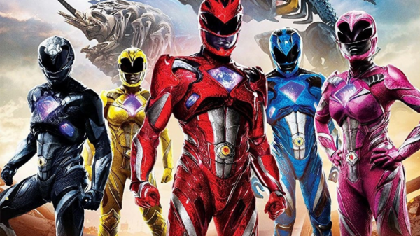
Pawer rangers day
Teacher : Andres Torres
Student : Salvador Latorre
The topic : Pawer rangers day

Slide 2
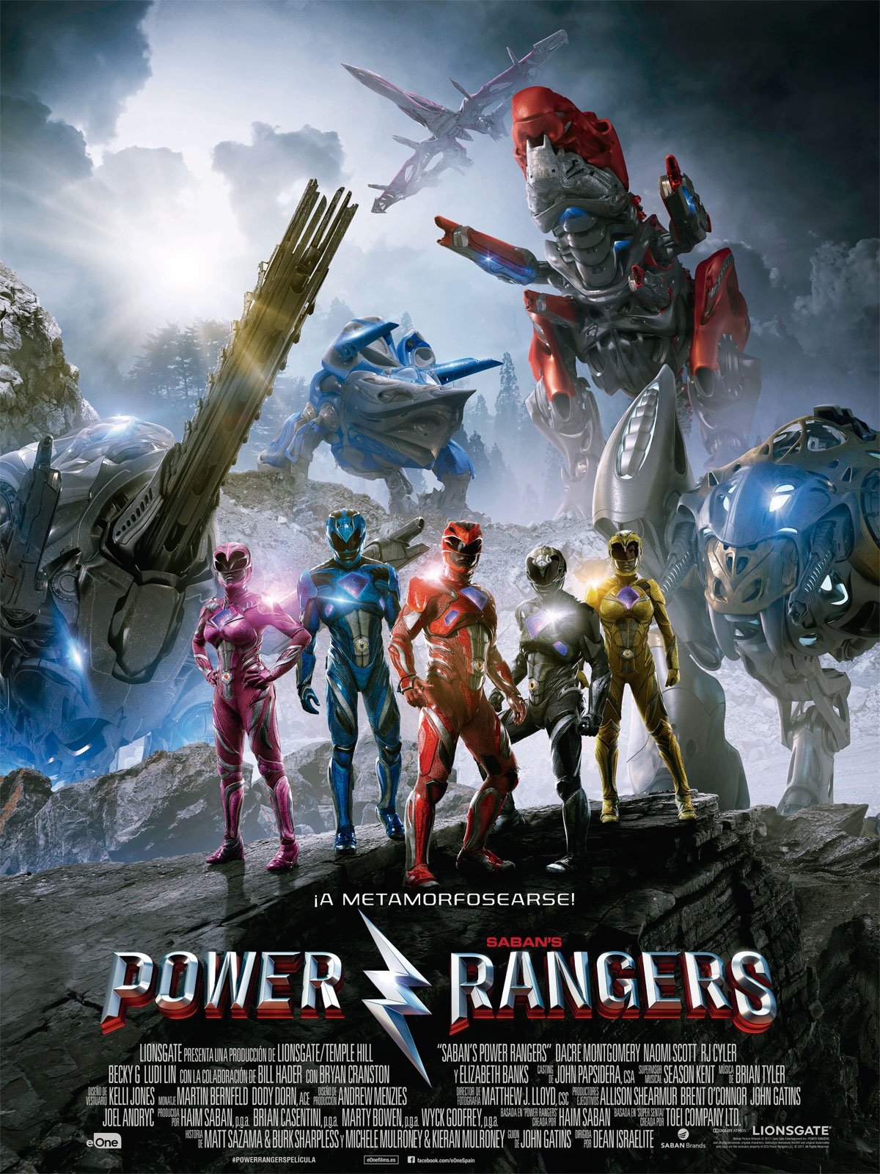
August 28th, It's Morphin' Time! National Power Rangers Day officially recognizes the original “teenagers with attitude” and celebrates all things Power Rangers!
pawer rangers day is important because we remember our childhood and the good times.

Slide 3
thank you teacher and classmates

