Slide 1
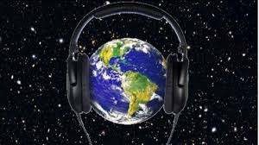
World Listening Day

Slide 2
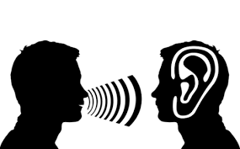
What is World Listening Day?
World Listening Day is celebrated as every year on July 18. It is a day in which it is intended to raise awareness and become aware of how sound affects daily life.
What is listening and what is its importance?
Good listening offers the possibility for the person who is speaking to us to communicate and express their thoughts, emotions and feelings. To adopt an attitude of listening is to separate our thoughts and concentrate on the expressions of the other.

Slide 3
What allows us to listen?
It teaches you to look at the whole and value other aspects that are also part of the message and that offer additional information, such as body language. Active listening improves emotional intelligence, assertiveness and contributes to personal development.

Slide 4
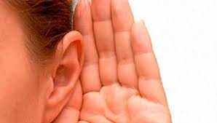
Thank you for your time

