Slide 1
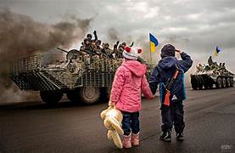
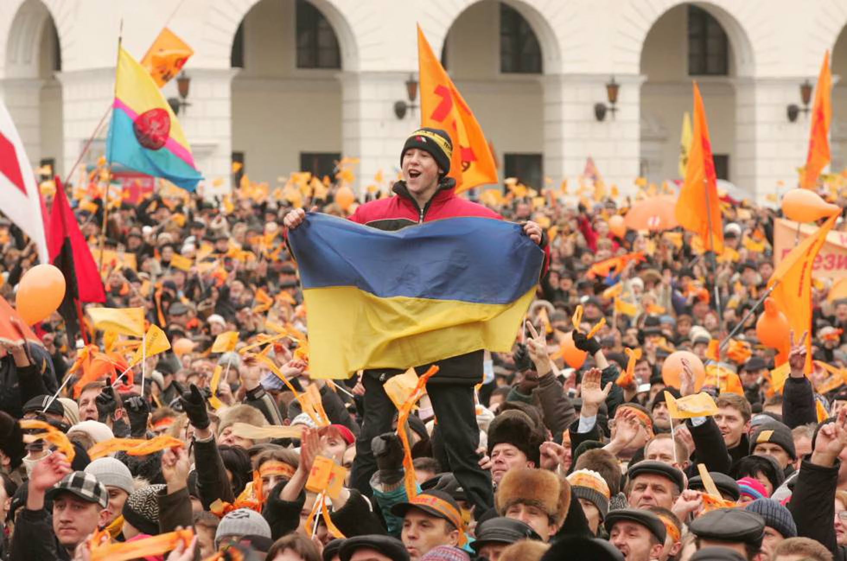
TODAY’S THE DAY
Student: Jorge Cornejo Carrizales
Date: Tuesday 24 of October 2023

Slide 2
Good morning teachers and classmates, today I am going to talk about, Ukraine formally declared its independence from the Soviet Union through the Ukrainian Declaration of Independence Act. First I would like to explain the declaration came after the Ukrainian parliament adopted the law of independence on August 24, 1991. Next I want to mention the declaration of independence was approved by a majority of Ukrainians in all regions of Ukraine in an independence referendum on December 1, 1991, followed by international recognition starting the next day. Ukraine's independence led to the dissolution of the Soviet Union on December 26, 1991. Since then, Ukraine has struggled to consolidate its independence and faced several political and economic challenges.

