Slide 1
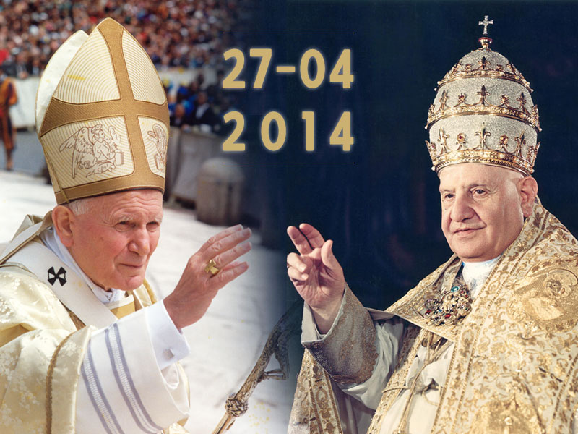
A Day like today
Adriano Bellina

Slide 2
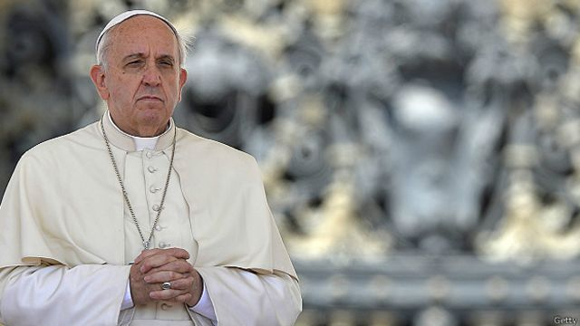
Popes John XXIII and John Paul II are canonized by Pope Francis
On Sunday, April 27, 2014, Popes John Paul II and John Twenty-three are canonized, this means that they were solemnly declared saints. The headquarters declared that they would be canonized on September 30, 2013 so that they can be canonized on a day like today by Pope Francis.

