Slide 1
Name and surname : Walter Fernandez Robles Teacher: Vladimir Solano Gonzales Course: INGLÉS B2 Grade and section: 5to B.sec Date: July 21, 2023
What day is today?
World dog day

Slide 2
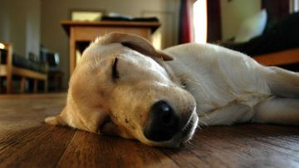
The dog has been a faithful companion of the human being throughout history. It has helped us to hunt, to watch over the herds, in our rescue efforts, to detect drugs or explosives, to guide the blind and a host of other things. But the most important thing is the company they keep us and the ability they have to cheer us up on a bad day.

Slide 3
For all these reasons, these animals have become our best friends and, as such, they deserve recognition. Thus, in 2004 it was established that World Dog Day would be celebrated internationally every July 21, although in countries such as the United States, Guatemala or Colombia, it was set on August 26. However, this event is not only to honor them and show our gratitude, but it was also created to raise awareness about the abandonment and adoption of this species, since, according to estimates by the World Health Organization (WHO), there are more than 300 million dogs in the world and 70% are homeless.

Slide 4
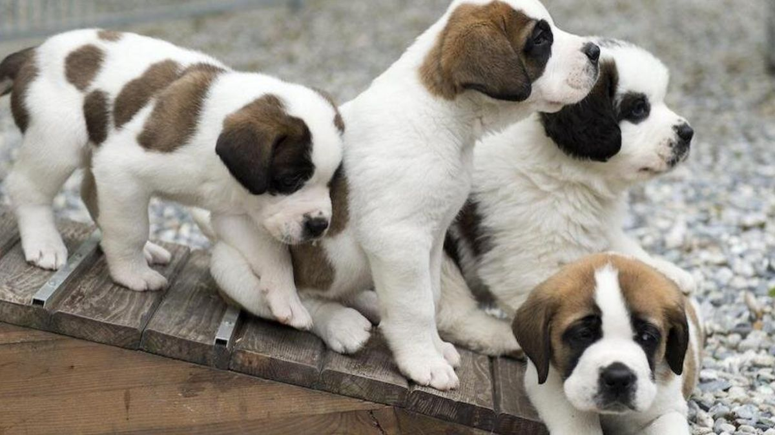
When they come into our lives, they become a member of the family, so it is normal to want to celebrate this day. In previous years, events were organized in some places for owners and pets to interact, but the pandemic has made it difficult to practice. However, we can spend the day with them, giving them a different meal or taking advantage of the special promotions launched by some dog stores and buy something special for our furry friend.

Slide 5
CONCLUSION
In my conclusion, I believe that the dog has become man's best friend over the years and this has formed family ties thus giving them the love they need to be happy and they are also important and recognized by the police for their great sense of smell to recognize proper substances.

