Slide 1
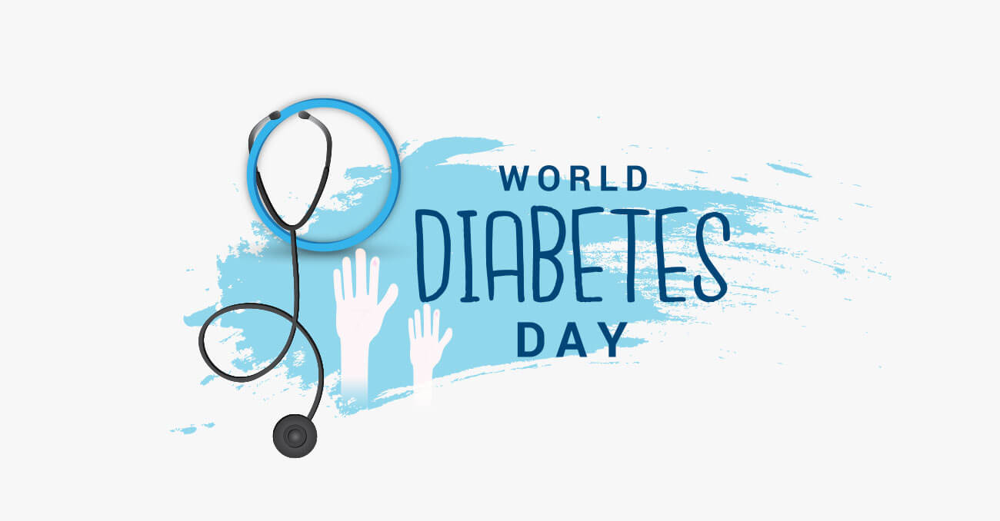
November 14th

Slide 2
What is Diabetes?
Diabetes is a chronic, metabolic disease characterized by elevated levels of blood glucose (or blood sugar), which leads over time to serious damage to the heart, blood vessels, eyes, kidneys and nerves.

Slide 3
Every November 14th, World Diabetes Day is commemorated, which is an opportunity to raise awareness about the impact of diabetes on the health of people. It also seeks to highlight the opportunities to strengthen the prevention, diagnosis, and treatment of diabetes.

Slide 4
Why is World Diabetes Day on November 14?
World Diabetes Day became an official United Nations Day in 2006 with the passage of United Nation Resolution 61/225. It is marked every year on 14 November, the birthday of Sir Frederick Banting, who co-discovered insulin along with Charles Best in 1922.
100 years ago, Frederick Banting and John Macleod won a Nobel Prize for discovering the treatment which has gone on to save millions of lives around the world - insulin.

