Slide 1
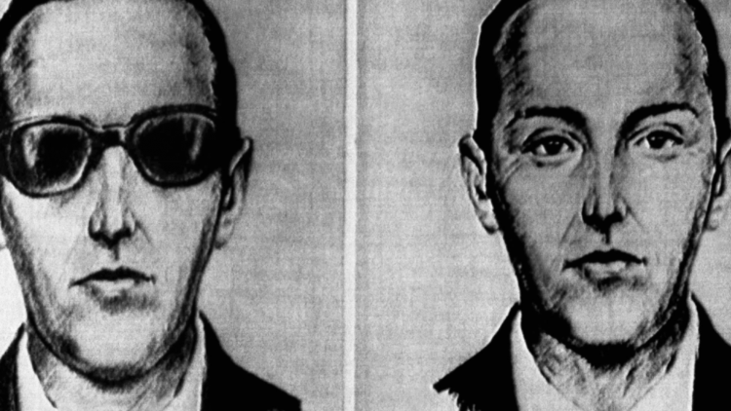
THE MISTERY OF D.B COPPER

Slide 2
First captivating attention by commandeering a commercial flight, Cooper then demanded a ransom and a parachute. Then, in a bold move that left investigators perplexed, he parachuted into the unknown.
The middle act of this saga is marked by a void—no concrete evidence or leads to unmask the elusive hijacker. The story of Cooper, dressed in sunglasses and a black suit, became a symbol of criminal mystique.
Finally, as decades passed, the legend endured, with the true identity and whereabouts of Cooper remaining elusive. The final act of this captivating tale remains an open-ended question, shrouded in the fog of mystery.
In conclusion, D.B. Cooper's audacious hijacking, mysterious disappearance, and enduring legend make this story a captivating chapter in criminal history. First capturing attention, then disappearing into the shadows, and finally leaving an indelible mark on popular culture, Cooper's saga continues to fuel speculation and fascination with unsolved mysteries.

