Slide 1
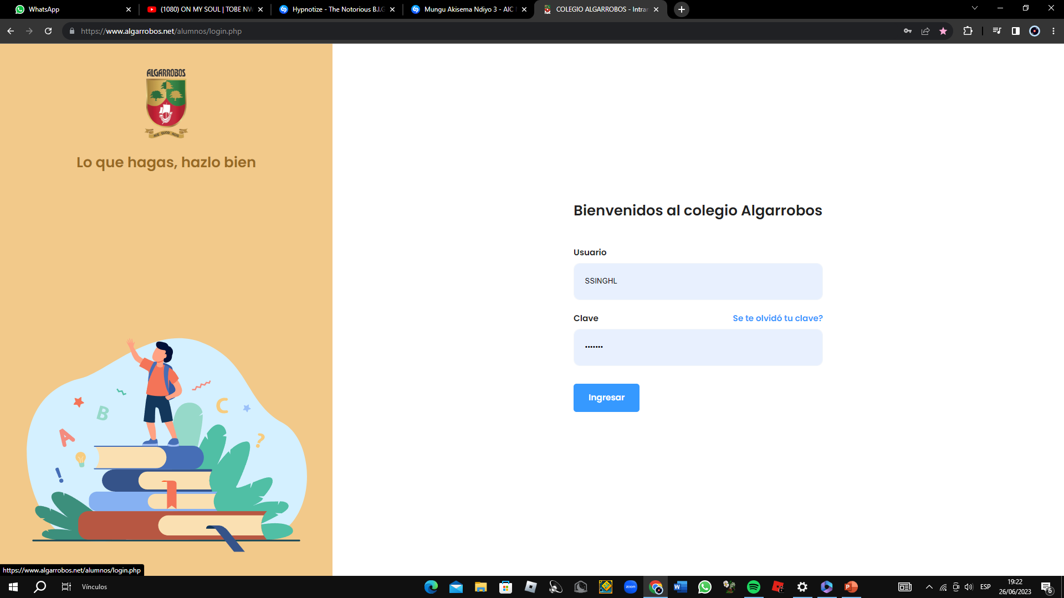
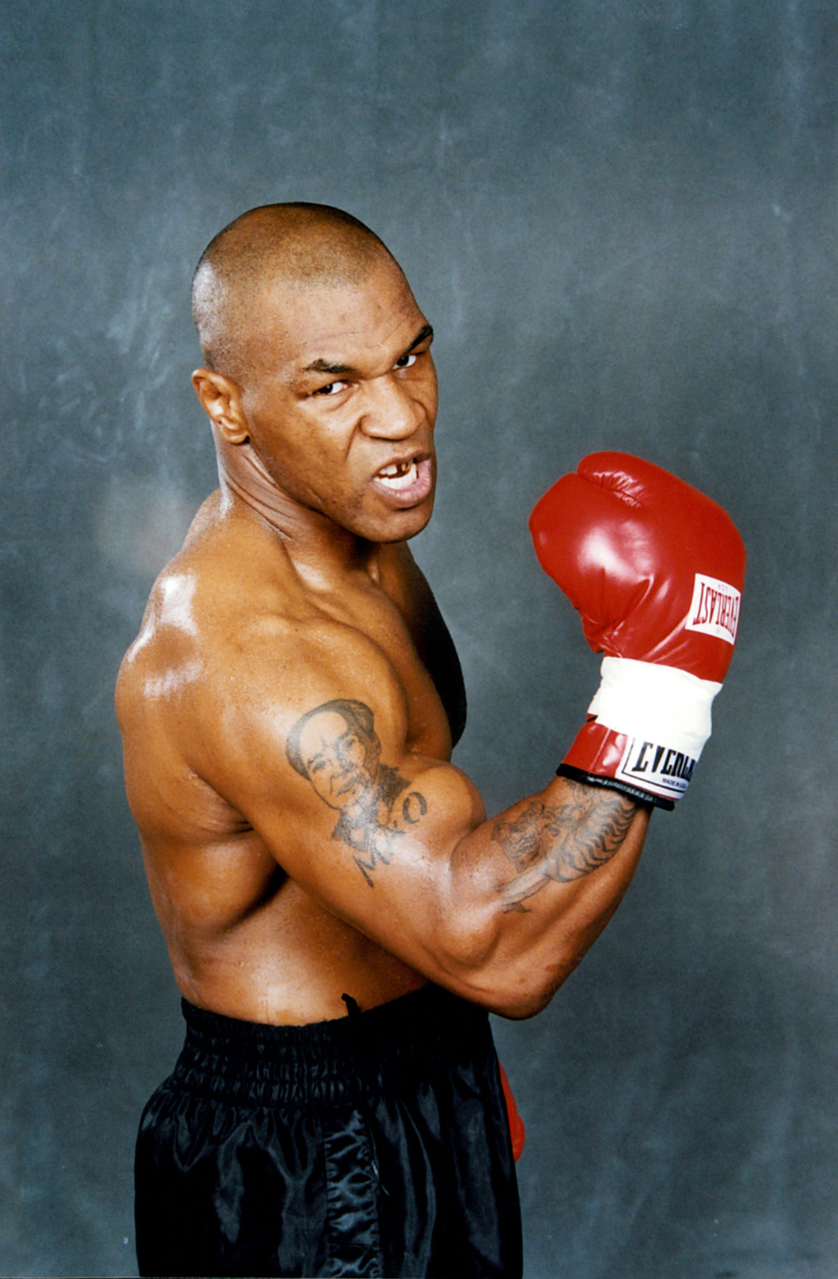
MIKE TYSON
“Iron Mike” - "Kid Dynamite“
“The Baddest Man on the Planet”
TEACHER: VLADIMIR SOLANO.
BY: SAIHAJ SINGH LAURE

Slide 2
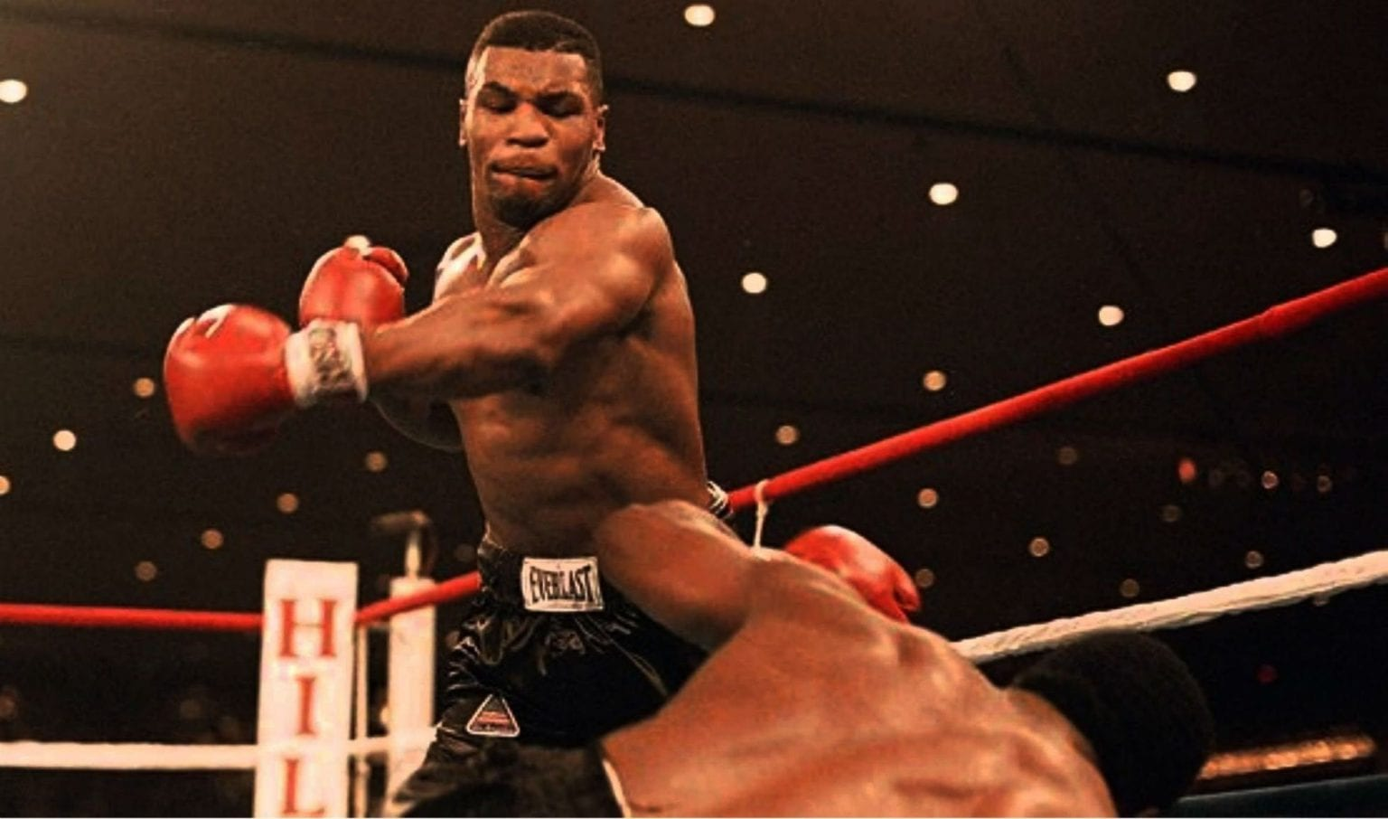
Michael Gerard Tyson (born June 30, 1966)
Is an American former professional boxer who competed from 1985 to 2005.
Tyson is considered to be one of the greatest heavyweight boxers of all time.
Tyson made his professional debut as an 18-year-old on March 6, 1985.
He won his first 19 professional fights by knockout.
Tyson holds the record as the youngest boxer ever to win a heavyweight title.
In 1992, Tyson was convicted of rape and sentenced to six years in prison, although he was released on parole after three years.

Slide 3
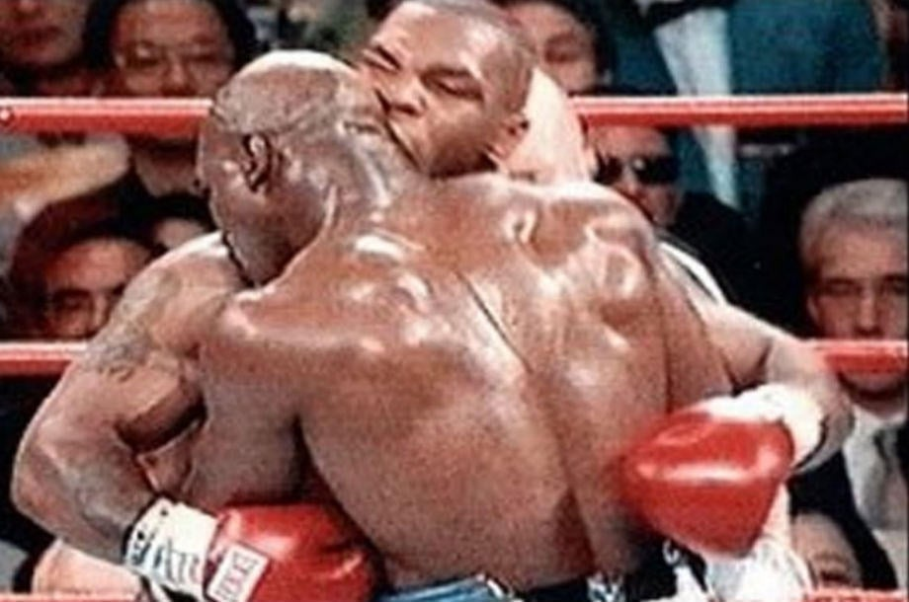
Tyson vs. Holyfield (June 28, 1997)
the fight was stopped at the end of the third round, with Tyson disqualified for biting Holyfield on both ears.
The first time Tyson bit him, the match was temporarily stopped. Referee Mills Lane deducted two points from Tyson and the fight resumed. However, after the match resumed, Tyson bit him again, resulting in his disqualification, and Holyfield won the match.
The first bite was severe enough to remove a piece of Holyfield's right ear, which was found on the ring floor after the fight, Tyson later stated that his actions were retaliation for Holyfield repeatedly headbutting him without penalty In the confusion that followed the ending of the bout and announcement of the decision, a near riot occurred in the arena and several people were injured. Tyson was the first heavyweight title fight in over 50 years to end in a disqualification.

Slide 4
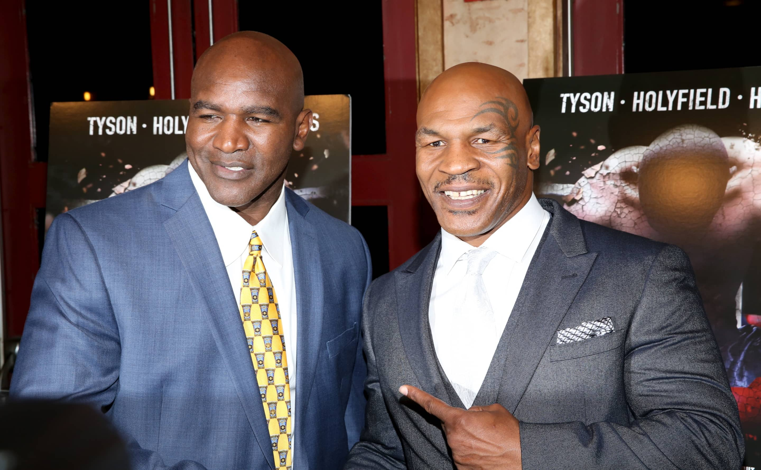
Tyson vs. Holyfield
Two days after the fight, Tyson issued a statement,apologizing to Holyfield for his actions and asked not to be banned for life over the incident.Tyson was roundly condemned in the news media but was not without defenders.

Slide 5
