Slide 1
National Power Rangers Day
Alumno: Johnny Fernando Grados Neyra
Tutor: Andrés
Curso: INglés

Slide 2
¿When its the Power Rangers day?
Power Dangers day is celebrated on August 28th.
And is celebrated in the United States

Slide 3
¿Why Power Rangers day is celebrated?
In the United States the first series was broad cast in 1993 in August, therefore Hasbro Which is a toy Company puts the 28th of that month as the day of the Power Rangers to remember the day of its history and all its fans want that day.

Slide 4
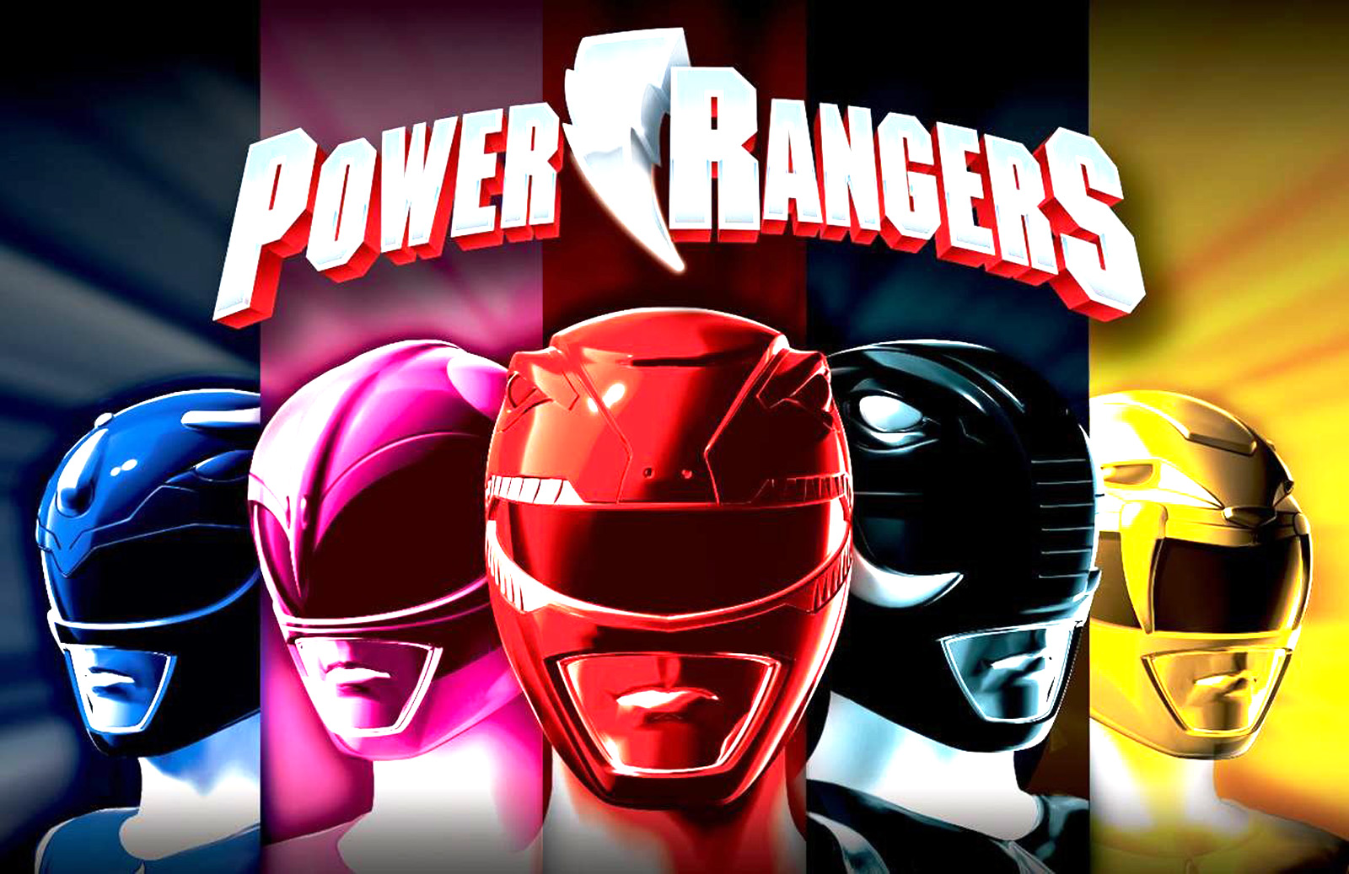
Thank you teacher and classmates

