Slide 1
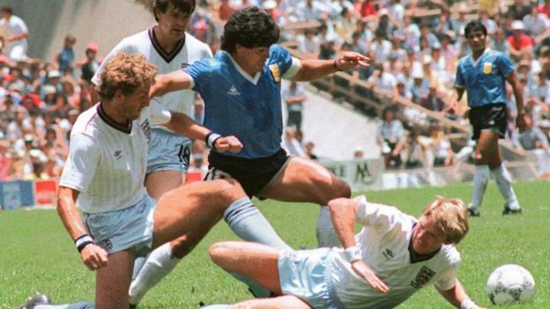
Today’s the day
Argentina advances to the quarterfinals in the 1986 World Cup in Mexico

Slide 2
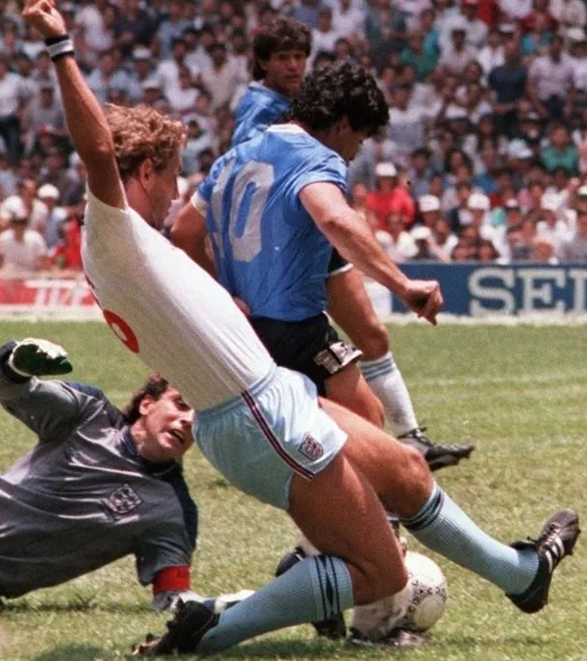
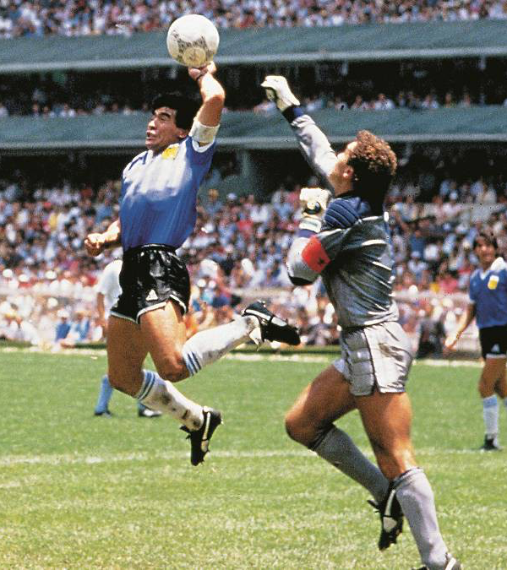
Argentina beat England with two amazing goals from Diego Armando Maradona in the 1986 World Cup in Mexico. Maradona scored his most famous goals in that match:
"The Goal of the Century" and "The Hand of God". The match ended with a 2- 0 going to the quarterfinals and so on until reaching the final and winning the world cup that year.

