Slide 1
The battle of Gamonal/The battle of Burgos

Slide 2
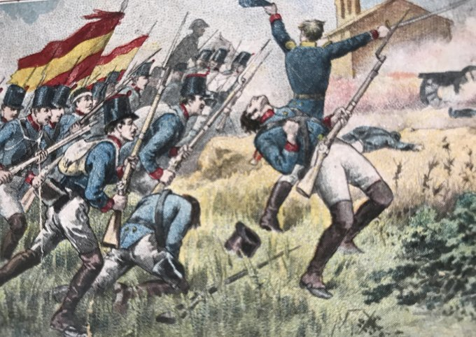
A day like today
Happened the Gamonal´s battle (also known as Burgo´s battle) it was a battle on the actual neighborhood of Burgos, the battle bas between the Napoleón tropes and Ramon Patiño (count of Belveder) ones; at the end of the battle Patiño´s tops were defeated and that gave way to the plundering of the Burgo´s city

Slide 3
Finally, i would like to conclude saying the consequences of the battle
The winners entered on the city and looted 2000 bags of fine wool, Napoleon settled on Burgos, and the 12 of november forgives all spanish people wo reject any kind of alliance with England. After all of that, Napoleon went to Madrid, leaving behind his brother José

Slide 4
Many thanks
For your atention

