Slide 1
what happened on a day like today?
Name: Juan Renato Tello Espejo
Teacher: Vladimir Solano Gonzales
Course: English
Date: Today 30th of June of 2023

Slide 2
Michael Phelps
Birthey: Today 30th of June of 1985
Born: Baltimore, United States
Sport: Swimming
Won: 28 medals

Slide 3
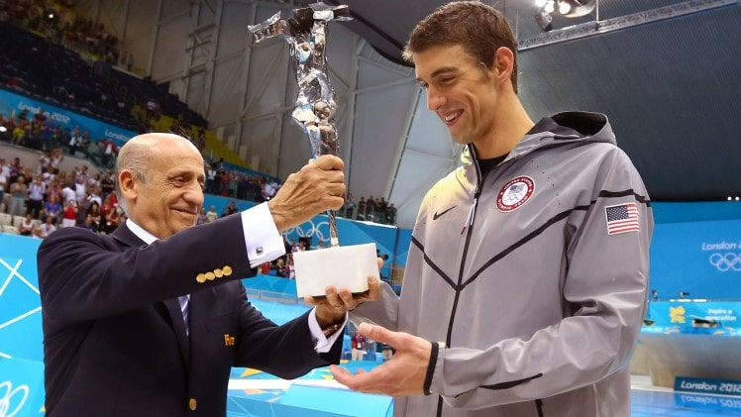
Phelps won six gold and two bronze medals in 2004 after competing in eight events:
200 freestyle
100 and 200 butterfly
200 and 400 medley
4 x 100 freestyle
4 x 100 medley
4 × 200 meters styles.

Slide 4
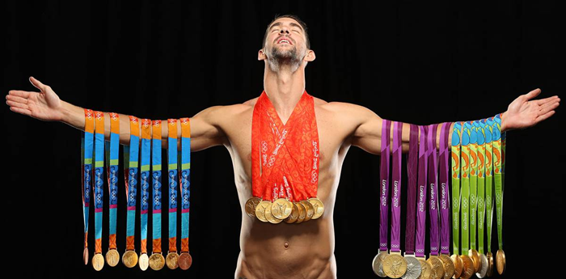
Conclusións:
In conclusion, Michael Phelps is considered one of the greatest swimmers of all time, set multiple world records in his career and has dominated the discipline of swimming during several Olympic Games.

