Slide 1
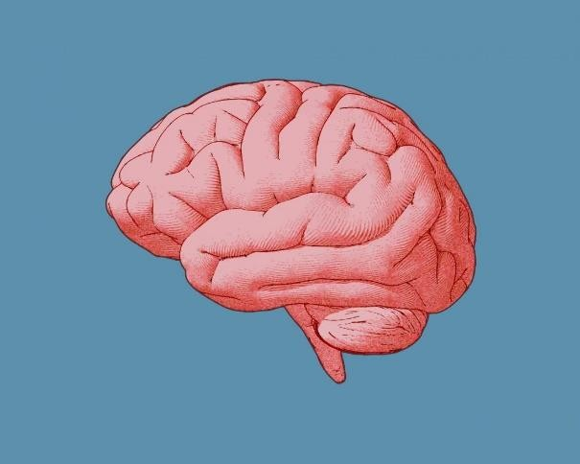


A2+: Worksheet 1: 18/06- Vocabulary Builder
A.
Look at the vocabulary list on page 72 and write 5 sentence with the
following words:
1.
Knowledge: my knowledge in maths is limited _.
2.
Creativity: In the nigth i am very creative
3.
Review: i like wacthing reviews videos in youtube.
4.
Tip: can you give me tips for fotball .
5.
Absolutely:
_.
B.
Describe the pictures with the correct word from the vocabulary list
intelligent
ability
efficient

