Slide 1
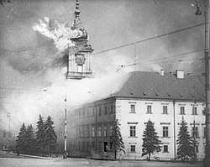
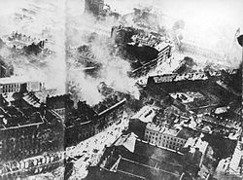
siege of warsaw

Slide 2
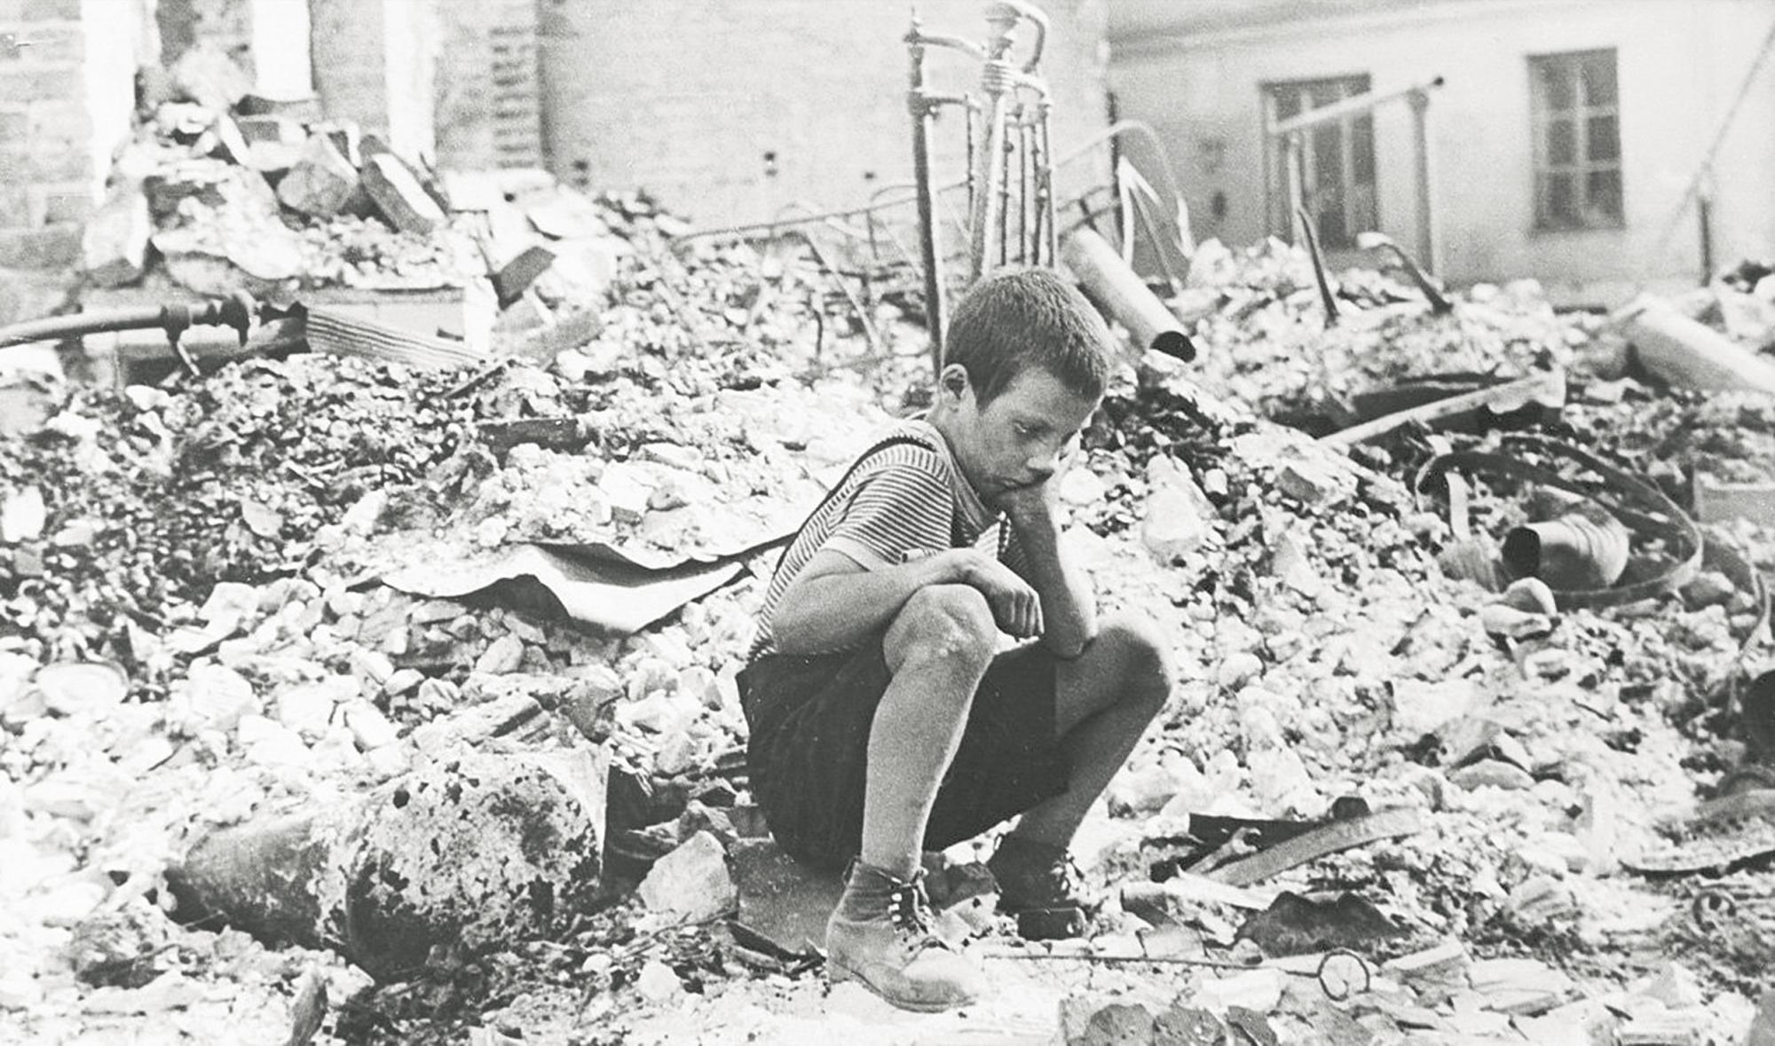
The 1939 Siege of Warsaw was a confrontation between units of the Polish Army defending the capital of Poland and the German Army, preceded by Luftwaffe bombing that began on September 1, 1939.
Ground combat began on September 8, when the first German armored units entered the Wola sector from the SE outskirts of the city. Despite triumphalist German reports, which announced a quick capture of the city, the attack was repulsed, thus beginning the siege of the capital. This was held until September 28, when the Polish garrison under General Walerian Czuma surrendered. The next day, about 100,000 Polish soldiers left the city and were taken as prisoners of war.

