Slide 1
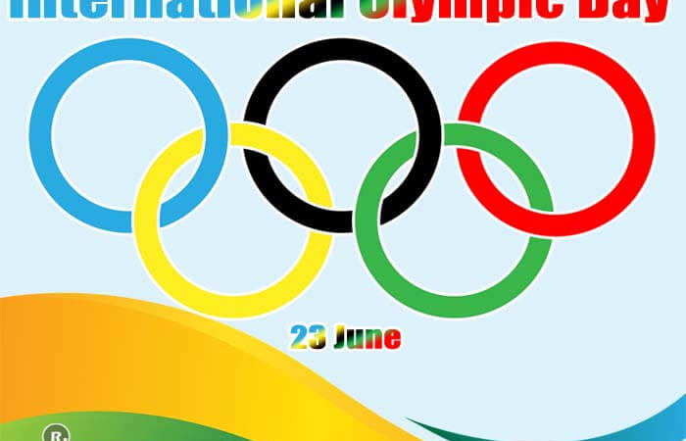
International Olympic Day
CURSO: Ingles
Alumno: Fabiano Vasquez Gomez
Good morning Professor and classmates Today I am going to present

Slide 2
International Olympic Day is celebrated on June 23 every year and was first observed in 1948. Thousands of athletes and sportsmen from all over the world participate in various games and sports. The modern Olympic Games are inspired by the ancient Greek Olympic Games held in Olympia, from the 8th century BC. until the fourth century after Christ. The first modern Summer Olympic Games were held in 1896 in Athens, Greece.

Slide 3
Thanks for your attention bye

