Slide 1
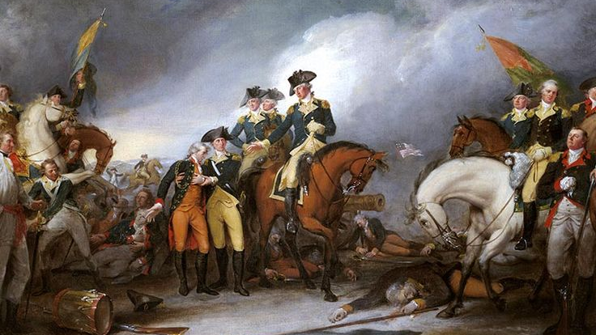
4th of July
U.S. Independence Day

Slide 2
The Declaration of Independence of the United States was on July 4, 1776, by the Second Continental Congress and the act was drafted by Thomas Jefferson which formally explained why the colonial ties that united the United States with England were broken and the 13 British colonies were proclaimed as the United States. sovereign and independent of the British regime and no longer recognized their rule.
The miscegenation in the United States was very large that made the American Indian population was very small almost reaching the disappearance

Slide 3
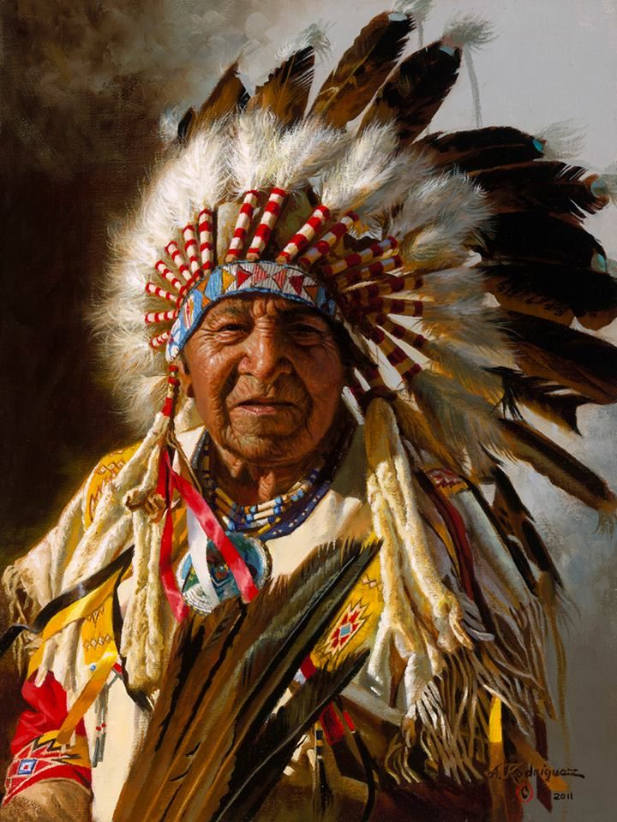
Characteristics of Ancient American Indians
They were divided into diverse tribes and cultures, with characteristics, clothing and customs.
American Indians are the first inhabitants of the American continent
Some of the best-known tribes are the Apaches, Sioux, Cherokees, Navajos, and

