Slide 1
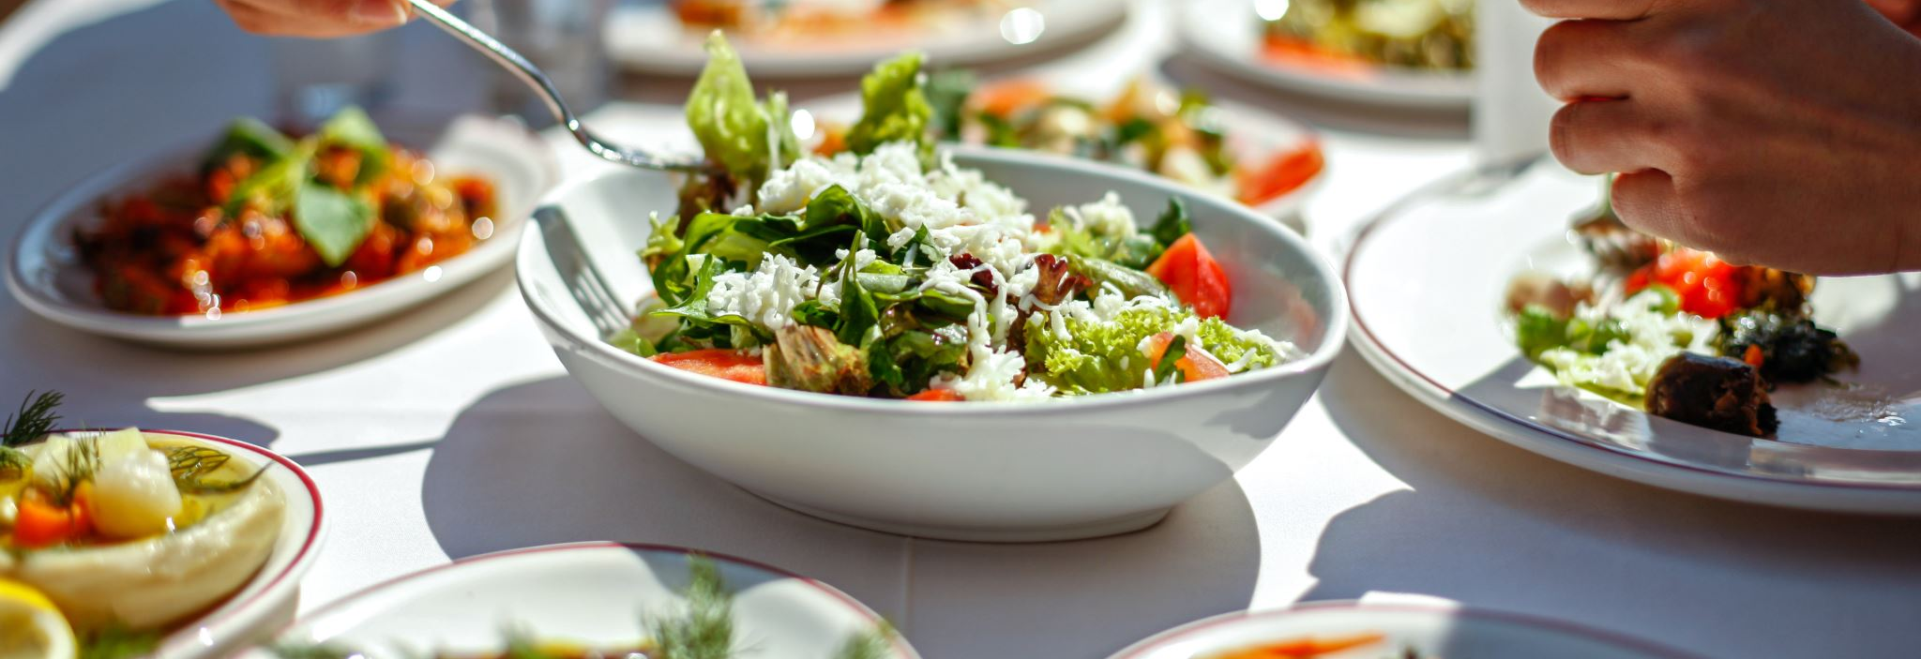
EAT OUTSIDE DAY
Facundo Rios Cabrera Aristi

Slide 2
Good morning teacher and classmates
Today i am goink to talk about the eat outside day.
Today is Friday, 1st of september and americans celebrate de eat outside day.
This day is based on going out and enjoying the fresh air while you eat, this day can be celebrated with family and friends, it can also be enjoyed on the beach, in the park, in a restaurant or in a food truck, food it tastes better when you enjoy it outdoors, in summary you could say that the eat outside day is a picnic or a day off to relax and have a good time.

Slide 3
THANK YOU FOR LISTENING

