Slide 1
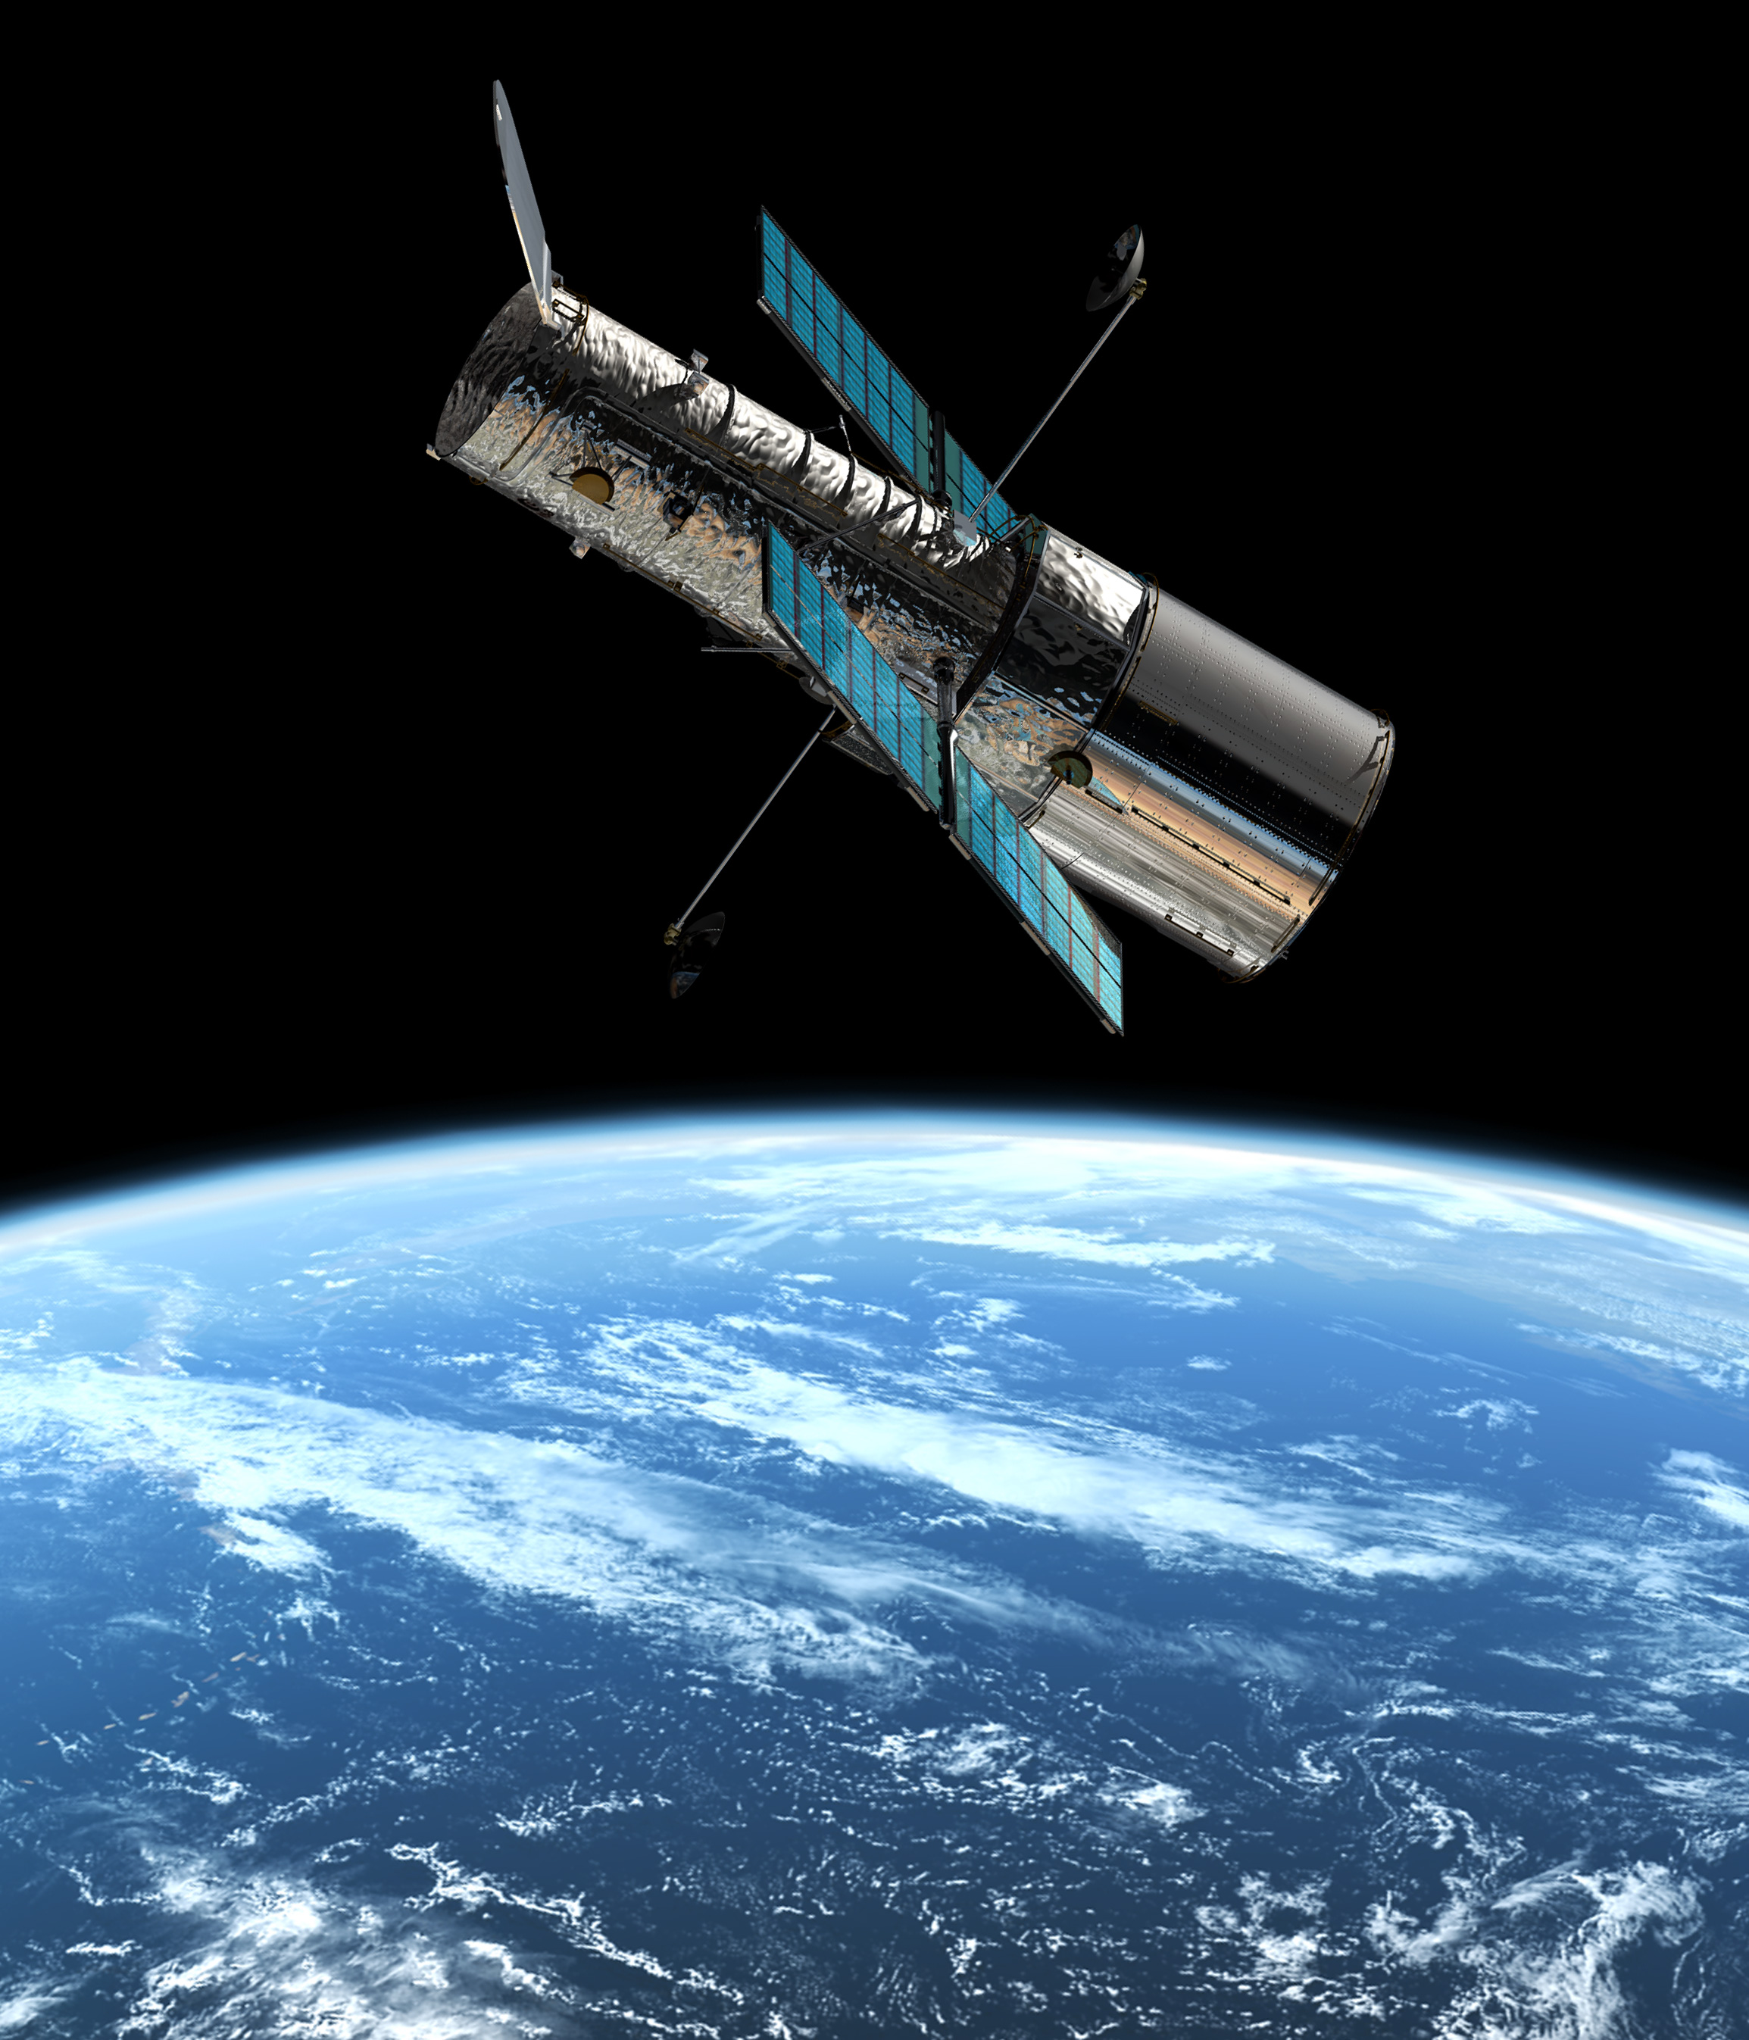
Hubble telescope

Slide 2
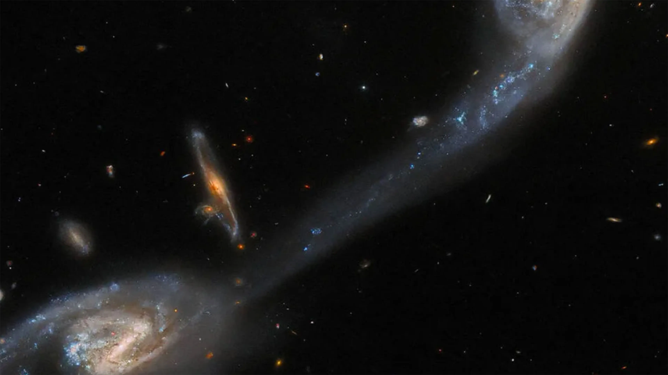
Today, Monday, April 24, 2023, the Hubble telescope was launched since 1990. It discovered approximately 10,000 galaxies, cost 2.8 billion dollars, has cameras that allow scientists to see billions of light years away, was able to see some of the most distant stars called icaro which is nine billion light years from Earth
thanks to the telescope we can study different phenomena and objects of the universe

