Slide 1
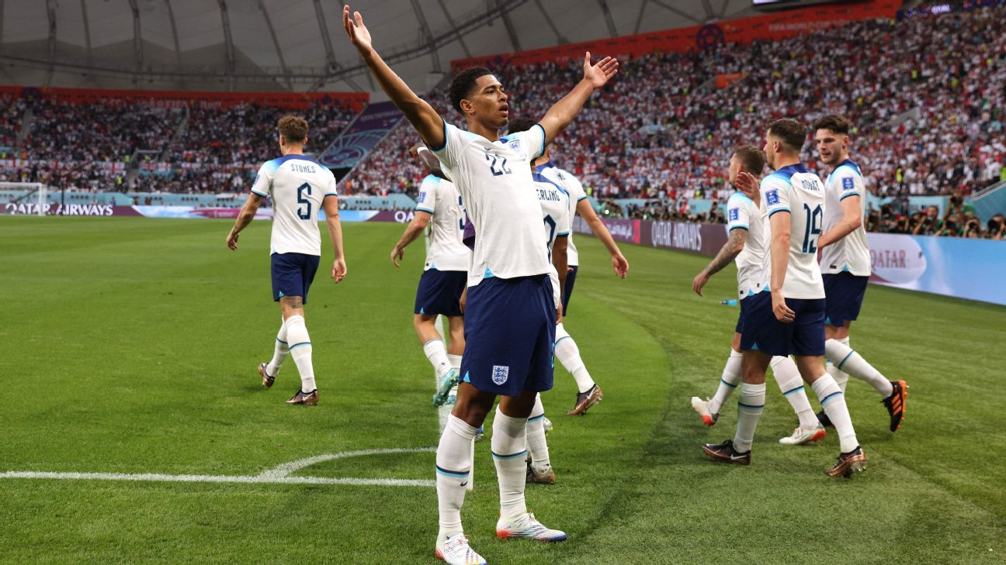
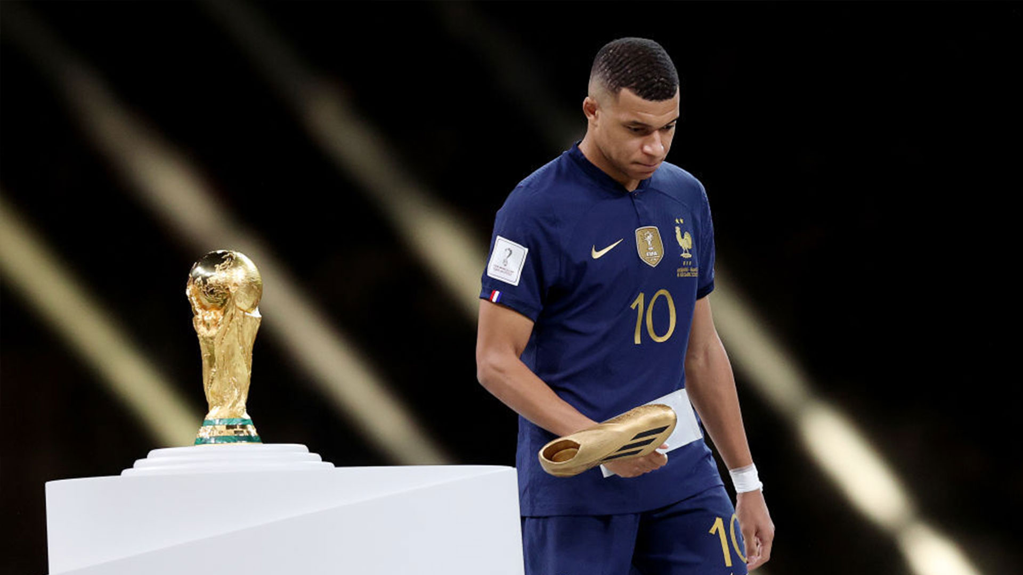
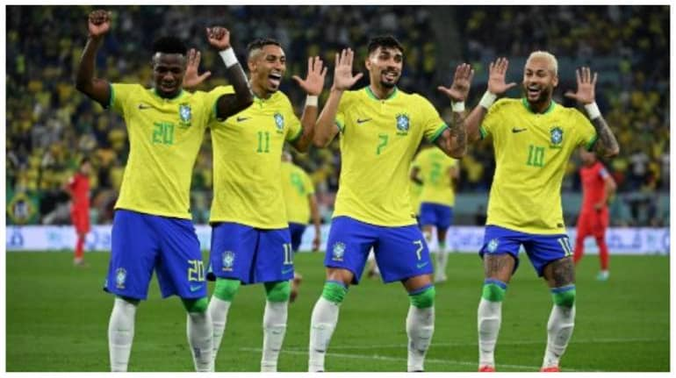
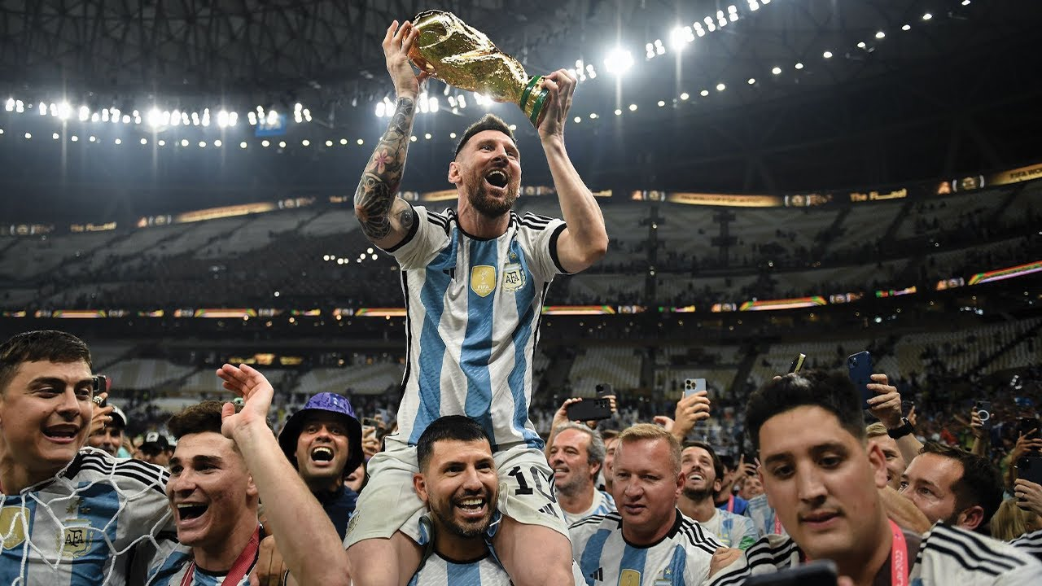
Start of the 2022 World Cup
Today is the day 20th of November

Slide 2
Today I am going to talk to you about the start of the 2022 World Cup, first I would like to explain to you that this World Cup was the first one that started in winter since summer is too hot in Qatar. Next I want to mention that Argentina won this World Cup after one of the best World Cup finals.

