Slide 1
A day like today
August 10th
By Gabriel Pastor

Slide 2
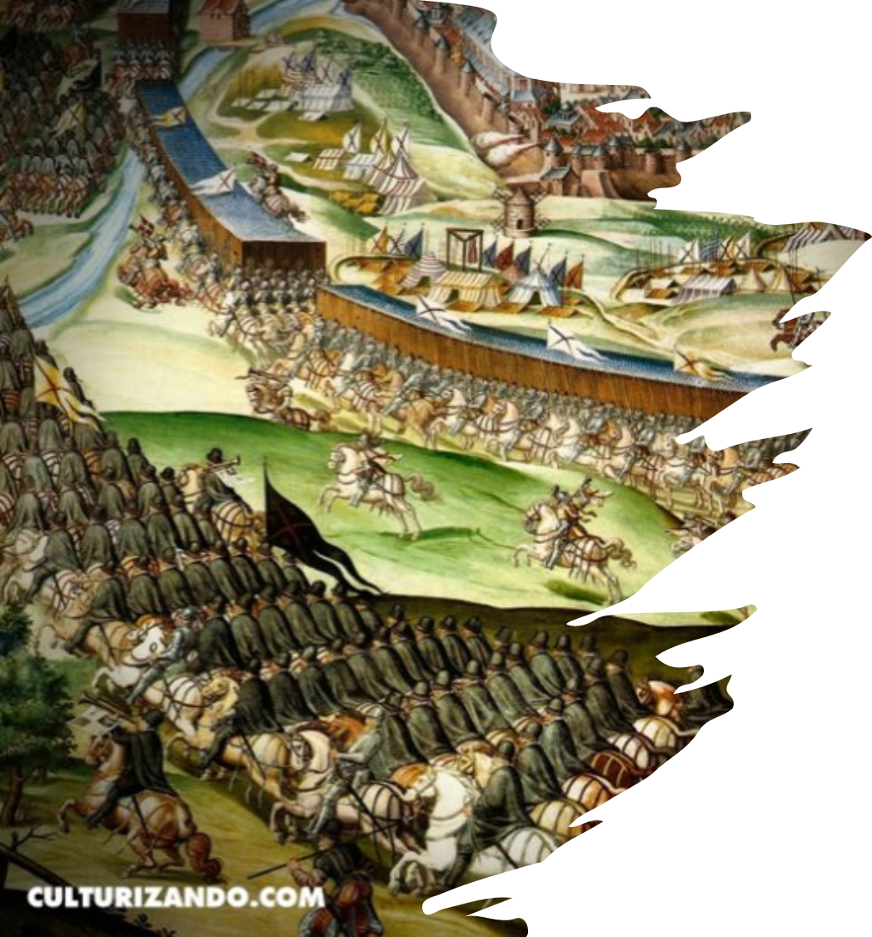
Good morning teacher and classmates,
Today I am going to talk about the Battle of Saint Quentin that took place in France, a day like today in 1557.

Slide 3
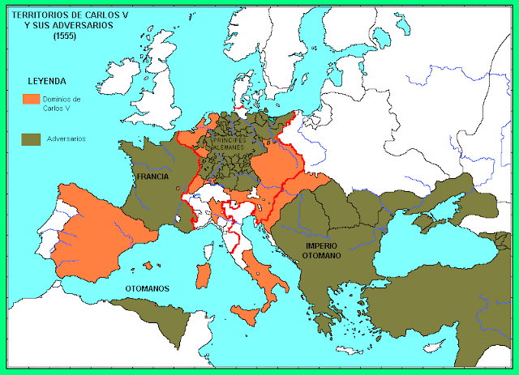
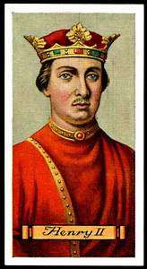
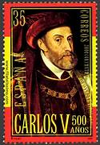
First, I would like to explain that this battle was part of the Italian War that began in 1551 when Henry II of France declared war against the Roman Emperor Charles V.

Slide 4
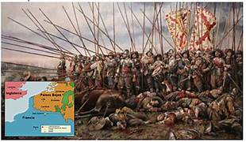
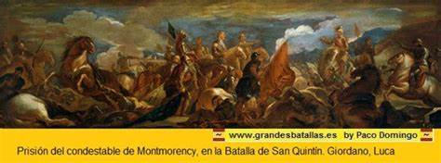
Next, I want to mention that in this battle, Lamoraal, Duke of Savoy (Spanish Empire) beat the Duke of Montmorency (France).
Finally, I will conclude by saying that they got the peace in 1559.

