Slide 1
My Oral Presentation
By : Josue Fabricio Pedraza

Slide 2
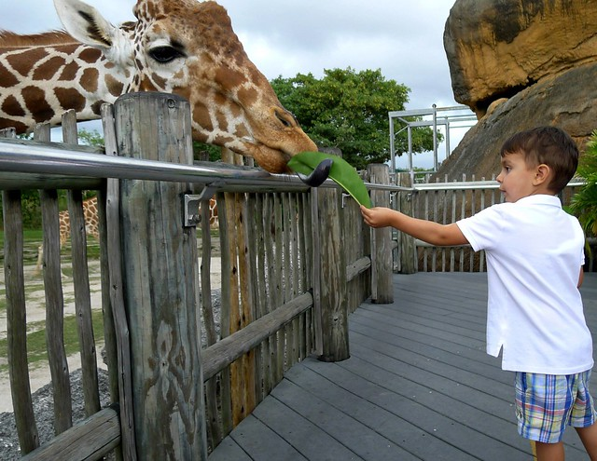
Today is 31 August and on this day we celebrate National Zoo Awareness

Slide 3
Good morning teacher and classmates. Today, I am going to talk about the National Zoo Awareness. Today is August 31nd and Americans celebrate National Zoo Awareness. This date is important because people It is celebrated on August 31 every year in the United Kingdom. Zoos have a long history dating back to ancient Egypt and have evolved over time to become more humane and scientific. Zoos can also be fun places to visit and learn about different animals and their habitats.

Slide 4
Thank you for listening, that was all teacher.

