Slide 1
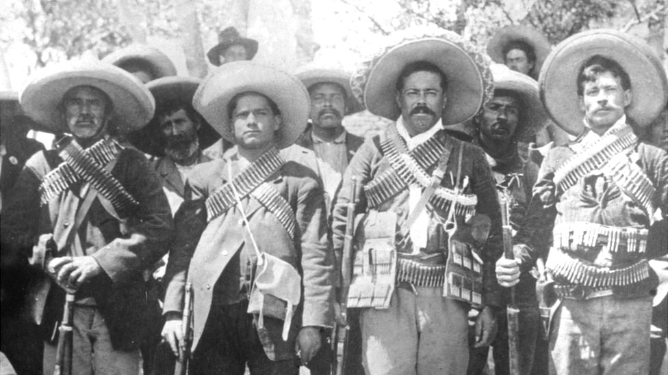
Mexican Revolution
Date: Tuesday 20th of November 2023
Student: Jorge Cornejo Carrizales
GRADE: 2 “A”

Slide 2
Good morning teachers and classmates, today I am going to talk about the Mexican revolution was a multifaceted movement that arose in response to various causes, the concentration of land in the hands of a few landowners, the lack of opportunities for the popular classes. Next I want to mention the revolt began on November 20, 1910, when Francisco Madero led an uprising against the authoritarian regime of Porfirio Díaz, a military man who became president and helped stabilize the country. Finally I will conclude by saying the revolution resulted in the drafting of a new Constitution in 1917, which established fundamental principles such as social justice, free secular education, and agrarian reform.

