Slide 1
INTERNATIONAL BEACH DAY
THIAGO FERNÁNDEZ FIESTAS

Slide 2
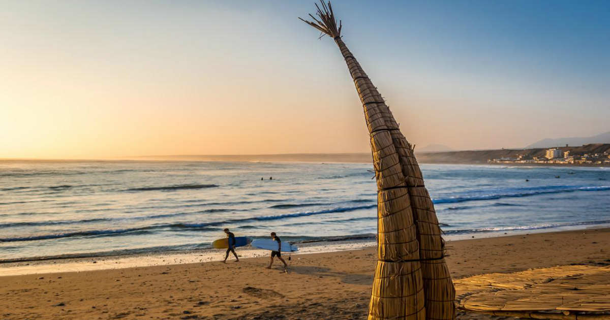
International Beach Day
Good morning teacher and classmates.
This morning, I am going to talk about the International Beach Day
The international beach day is september 1st

Slide 3
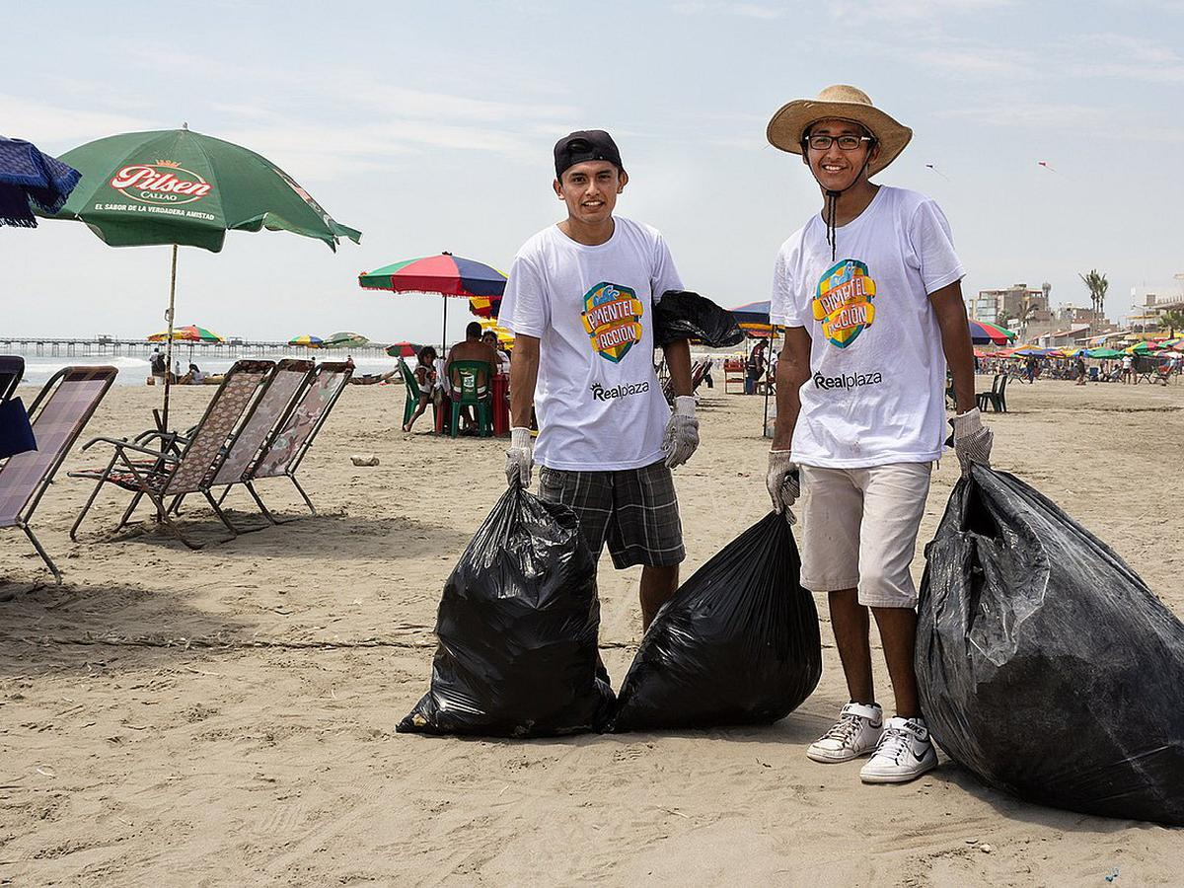
International Beach Day
This day is very important because the beaches are beautiful and amazing to enjoy and encourage healthy and fun outdoor activities like swimming, sports, building sandcastles, having a picnic, playing frisbee and simply enjoying the feel of sand between the toes but they also need to be taken care of and National Beach Day is a time where people are encouraged to do just that.

