Slide 1
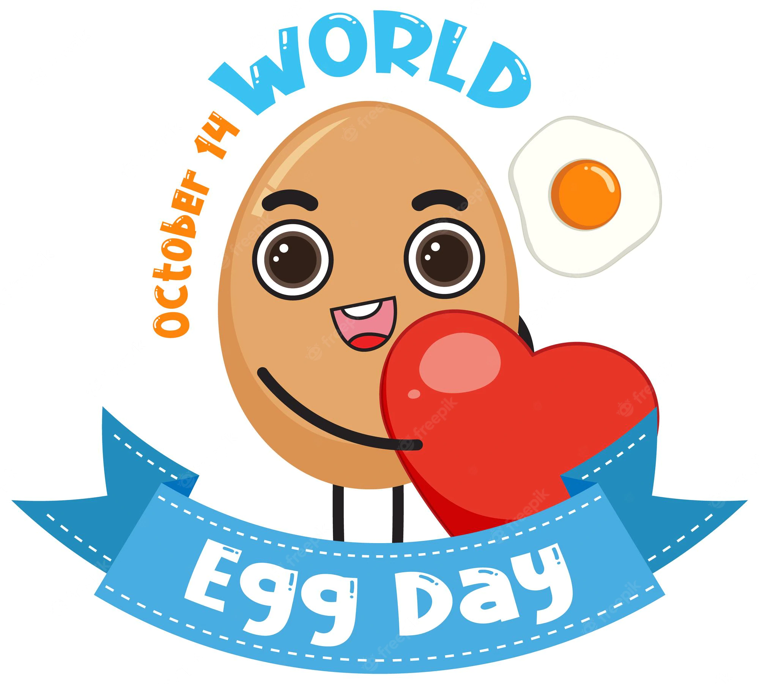
World egg day
Nombre: Greggory Vasquez

Slide 2
The second Friday of October is World Egg Day. On this peculiar day we celebrate nothing more and nothing less than the egg, for its relevance in our diet, as well as for the advantages and benefits it provides to nutrition and health.

