Slide 1
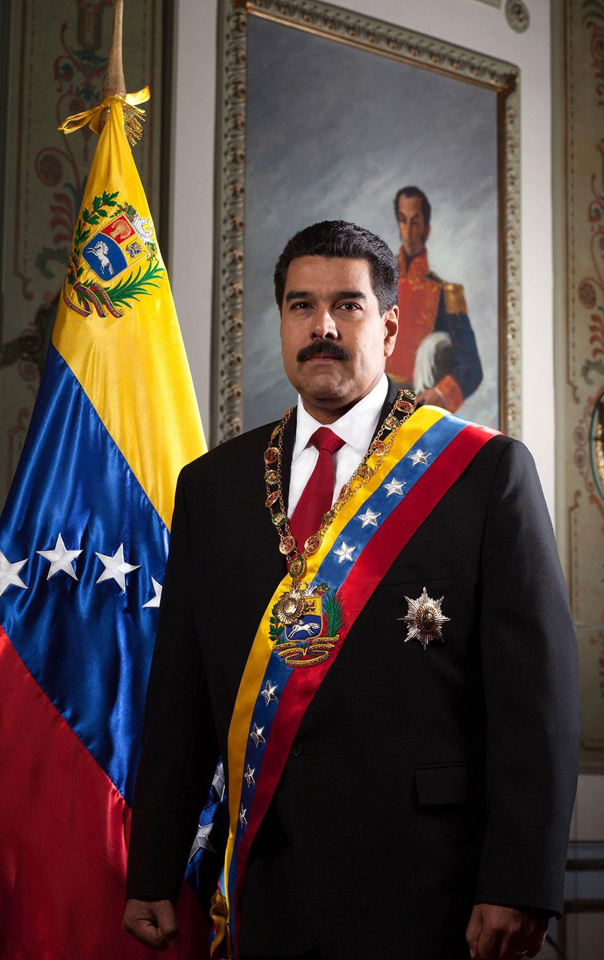
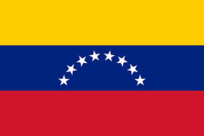
NICOLÁS MADURO
Nicolás Maduro was born on November 23, 1962 in Caracas in Venezuela.
First, who is Nicolás Mature?
Nicolas Maduro is the current president of Venezuela. Initially, he was a bus driver and trade unionist, but his career took a political turn when he joined the Chavista movement.
He later rose to power after the death of Hugo Chávez in 2013. However, his presidency has been marked by the economic and social crisis in Venezuela, with hyperinflation, food shortages and political repression.
Finally, Maduro has faced international criticism for his management and its negative impact on the quality of life of Venezuelans.
Thanks you for your time

