Slide 1
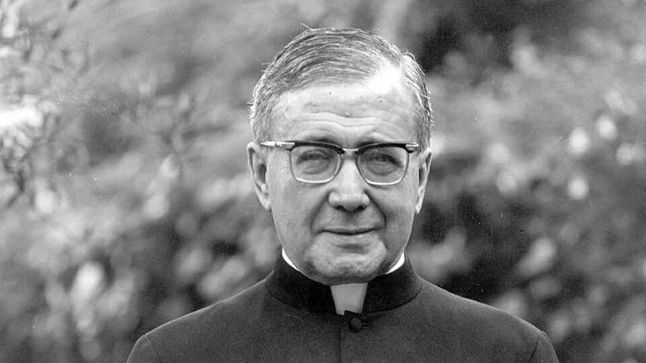
Date: Today´s Monday 26 of June, 2023
Today´s The Day: The of death of Saint San Jose Maria de Escriva de Balaguer
Presenter: George Lucas Conejo Carrizales

Slide 2
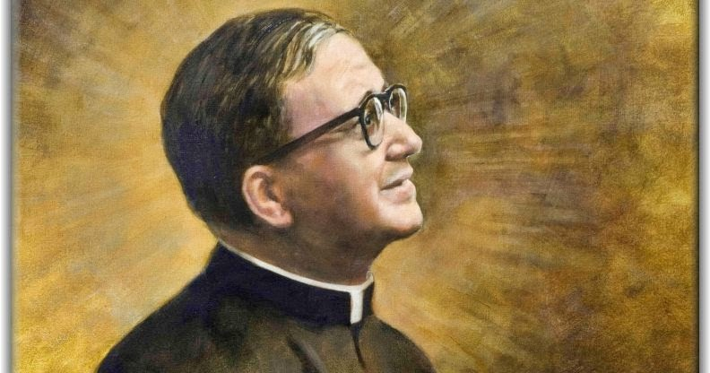
Today I am going to talk aboutthe day of death of saint Jose Maria de Escriva de Balaguer, first I want to explain saint Jose Maria de Escriva de Balaguer was born on june 9, 1902 and died on june 26, 1975,next I want to mention in his life that managed to found Opues Dei and proclaim it saint on october 6, 2003

