Slide 1
THE WORD POPULATION DAY
Name: Henrique Suyama Yazawa
Grade: 6´´b´´

Slide 2
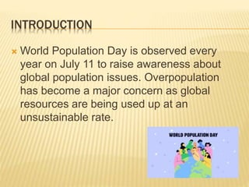

Slide 3
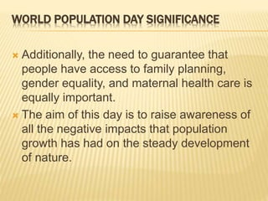

Slide 4


