Slide 1
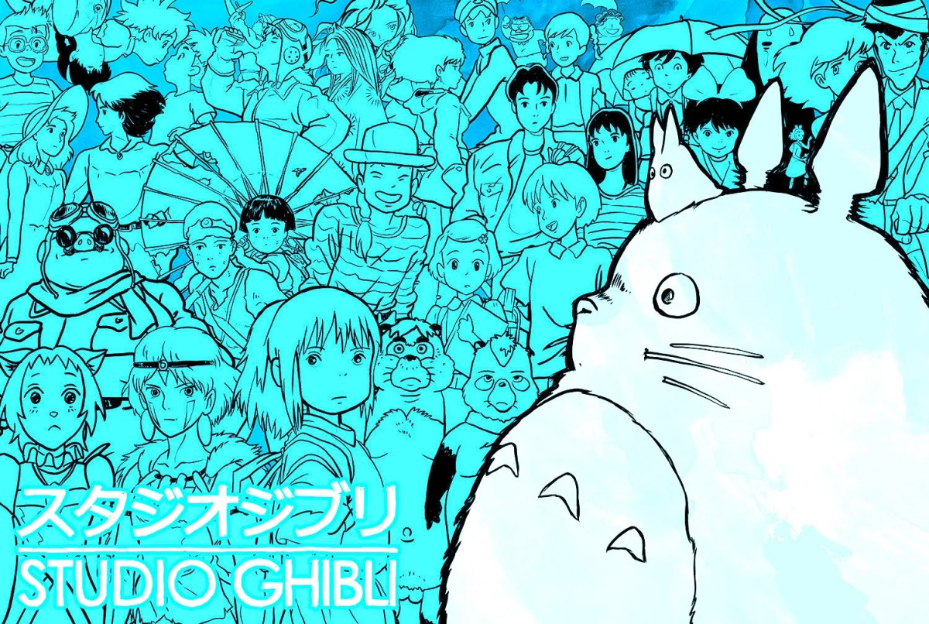
A Day Like Today
Name: Ales Junior De La Cruz Vega
Curse: Inglish
Date: Today Thursday 15th JUNe of 2023

Slide 2
Studio Ghibli
Well, today I am going to talk about the birth of Studio Ghibli, which was on June 15, 1985, by the famous award-winning director Hayao Miyazaki,.

Slide 3
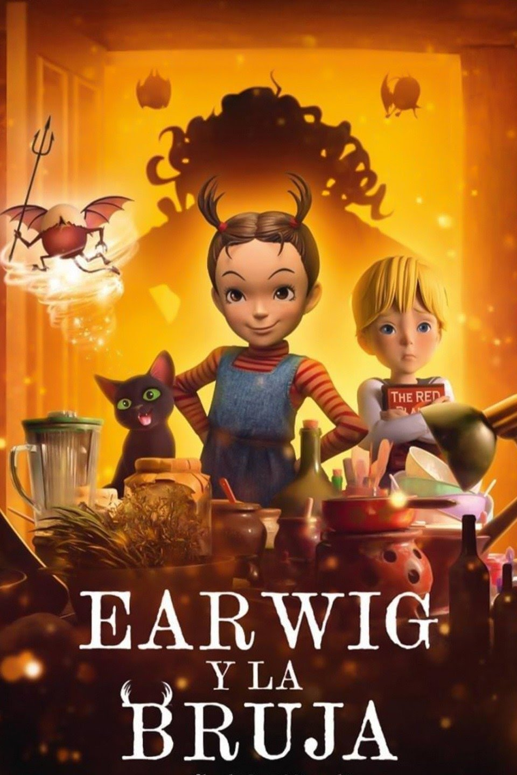
Movies
First, I would like to explain that Studio Ghibli has produced 23 films the last one was “Earwig and the Witch (Goro Miyazaki, 2020)“,

Slide 4
THE BEST FILMS FROM THE STUDIO
1. 'Spirited Away' (Hayao Miyazaki, 2001)
2. 'Porco Rosso' (Hayao Miyazaki, 1992)
3. 'The grave of the fireflies' (Isao Takahata, 1988)
4. 'Princess Mononoke' (Hayao Miyazaki, 1997)
5. 'My neighbor Totoro' (Hayao Miyazaki, 1988)

Slide 5
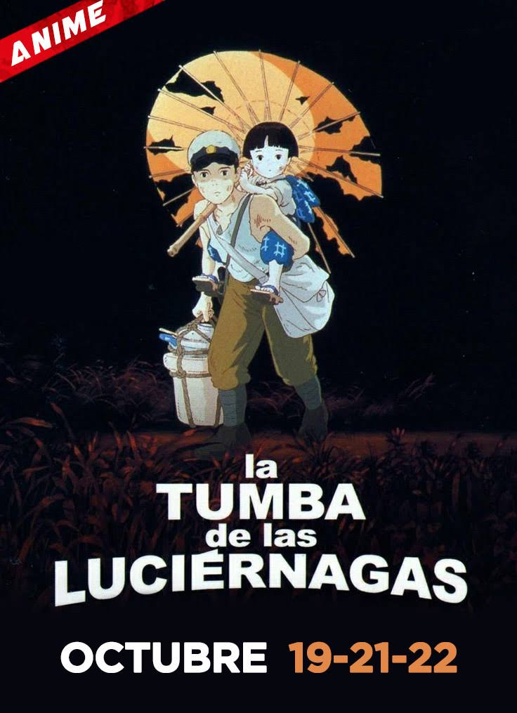
'The grave of the fireflies' (Isao Takahata, 1988)

Slide 6
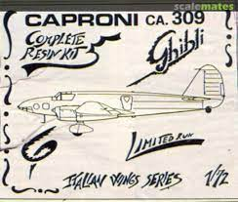
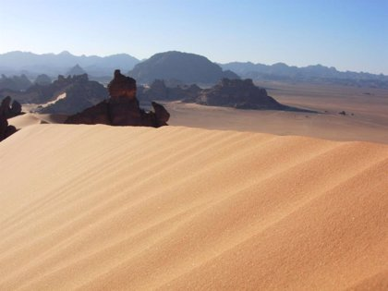
NAME
Next, I want to mention that, the name Ghibli derives from the Italian word "ghibli", based on the name of the hot desert wind that blows in Libya. It also refers to an Italian aircraft, the Caproni Ca.309 Ghibli.

Slide 7
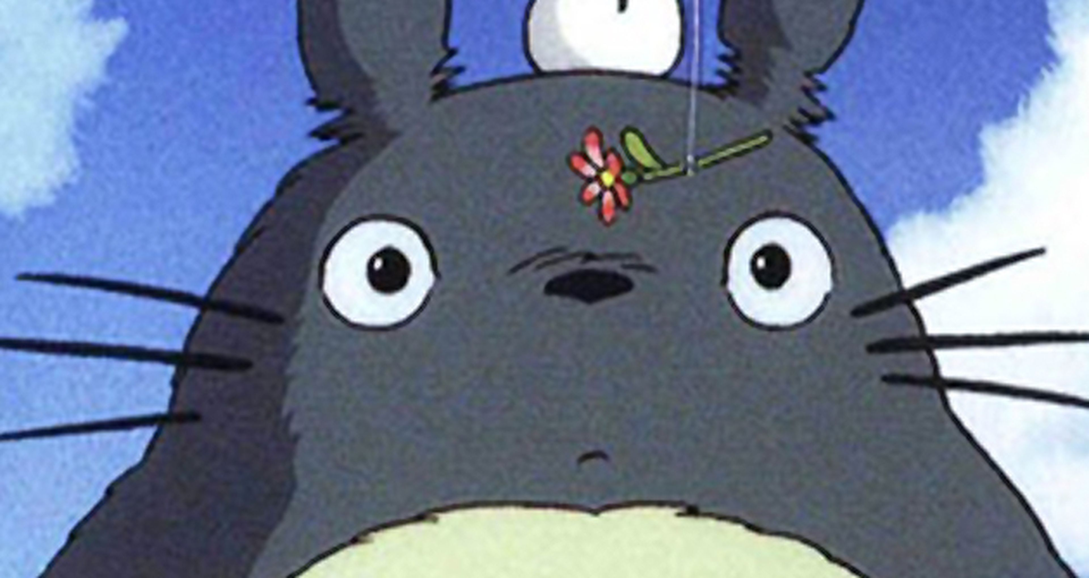
Production and realization techniques
Finally, I conclude by saying that Studio Ghibli is one of the animation studios that has remained faithful to traditional animation. That is to say, all his team carry out the productions using hand drawing that is not, instead of using computers.

