Slide 1
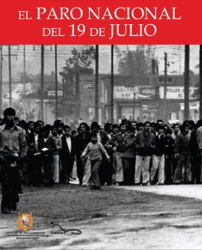
Good afternoon, everyone.
Today I am going to talk about the National Strike in 1977.
First, I would like to explain that on July 19, 1977, there was a National Strike promoted by the CGTP that demanded a general increase in wages due to the rise in the cost of living and the devaluation of the currency.
Next, in 1975 Francisco Morales Bermudez governed, after giving a military coup to the government of Velasco Alvarado, the political crisis affected the value of our currency, which is why they speak of devaluation.
Finally, with the devaluation, the purchasing power of Peruvians was reduced, consequently, with wages it was possible to buy less and less, for this reason an increase in wages was demanded to increase purchasing power.
Important fact:
It is considered a historic strike because it mobilized a large population in response to the increase in the value of fuel and necessities.

Slide 2
THANK YOU FOR LISTENING

