Slide 1
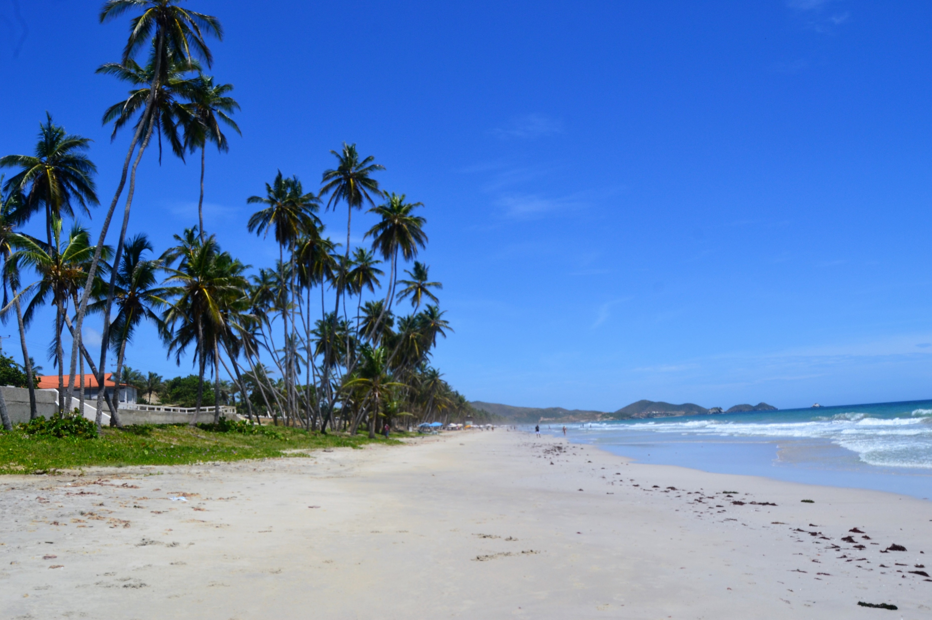
Dia nacional de la playa
Curso: English
Docente: Andrés Torres Arévalo
Alumno: Rodrigo Huamanchumo Urrutia

Slide 2
Why is national beach day celebrated?
This Day is intended to sensitize citizens so that througn environmental maintenance activities and work, for the improvement and conservation of marine-coastal-spaces, througt the collection and classification of solid waste on the beaches.

Slide 3
WHY WE LOVE NATIONAL BEACH
DAY
1.- It is important to be aware of the environment
Small and simple acts can have a big impact on the health of beaches and oceans. Walking more and switching to fluorescent bulbs can help reduce your carbon footprint. Avoid using so many plastic products, since many end up in the water. They can wreak havoc on coastal habitat.
2. It is an opportunity to be active outdoors
The beach offers countless opportunities to enjoy the outdoors and the sun. Take a dip in the ocean and enjoy some cool salt water on your skin. Lay back on a towel and give your skin some vitamin D. Set up a net for a game or two of beach soccer. Pack a picnic so you don't have to go outside, and be sure to stay to watch the sun set over the water!

Slide 4
3.- Promotes giving back to beach organizations
There are many organizations that help keep the beaches clean and fun all year long. If you live near a beach, check with your local organization to volunteer. And if there isn't, it would be important that you go to the beach with your family and after enjoying a good day, help to clean it up.

Slide 5
THANK YOU
Everyone loves a nice day at the beach, right? Celebrate your affinity for the seaside on August 30, National Beach Day. Started in 2014, this holiday raises our awareness of the beauty of the beaches while also calling attention to keeping them clean and safe.

