Slide 1
THE PAPER BAG DAY
Wednesday, 12th of July, 2023

Slide 2
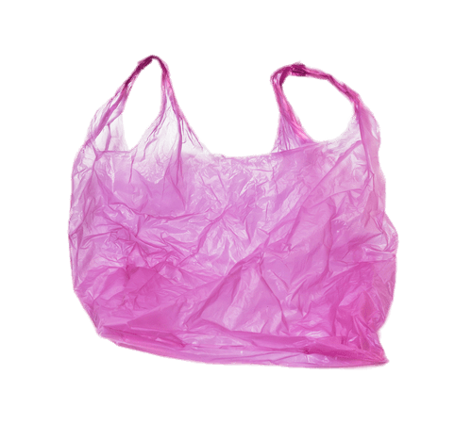
The paper bag:
The paper bag is good against environmental pollution since it is made of paper and paper is biodegradable.

Slide 3
thank you!!!!

