Slide 1
On this day
Teacher: Chris Lappin
Course: English
Student: Santiago Azalde
Grade: 2° of secundary
Date: 21(twenty-first) November 2022

Slide 2
What Happened today?

Slide 3
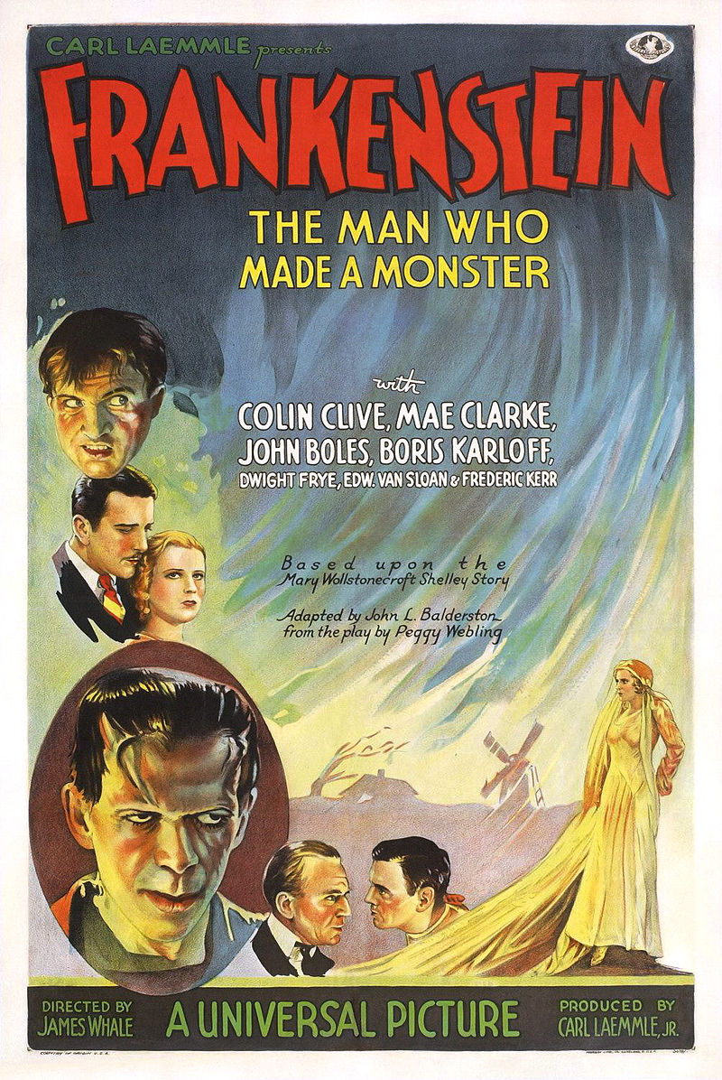
Some information
Boris Karloff starring as the monster, directed by James Whale.
Based on the story by Mary Shelley.
Duration 71 minutes and raised 12 million dollars.
He was nominated for the Oscars, the BAFTAs and the Saturn Awards.
The book of Frankenstein has 336 pages.
A collection with more than 150 original editions of the most famous books in the history of literature that has raised more than 6 million dollars.

Slide 4
