Slide 1
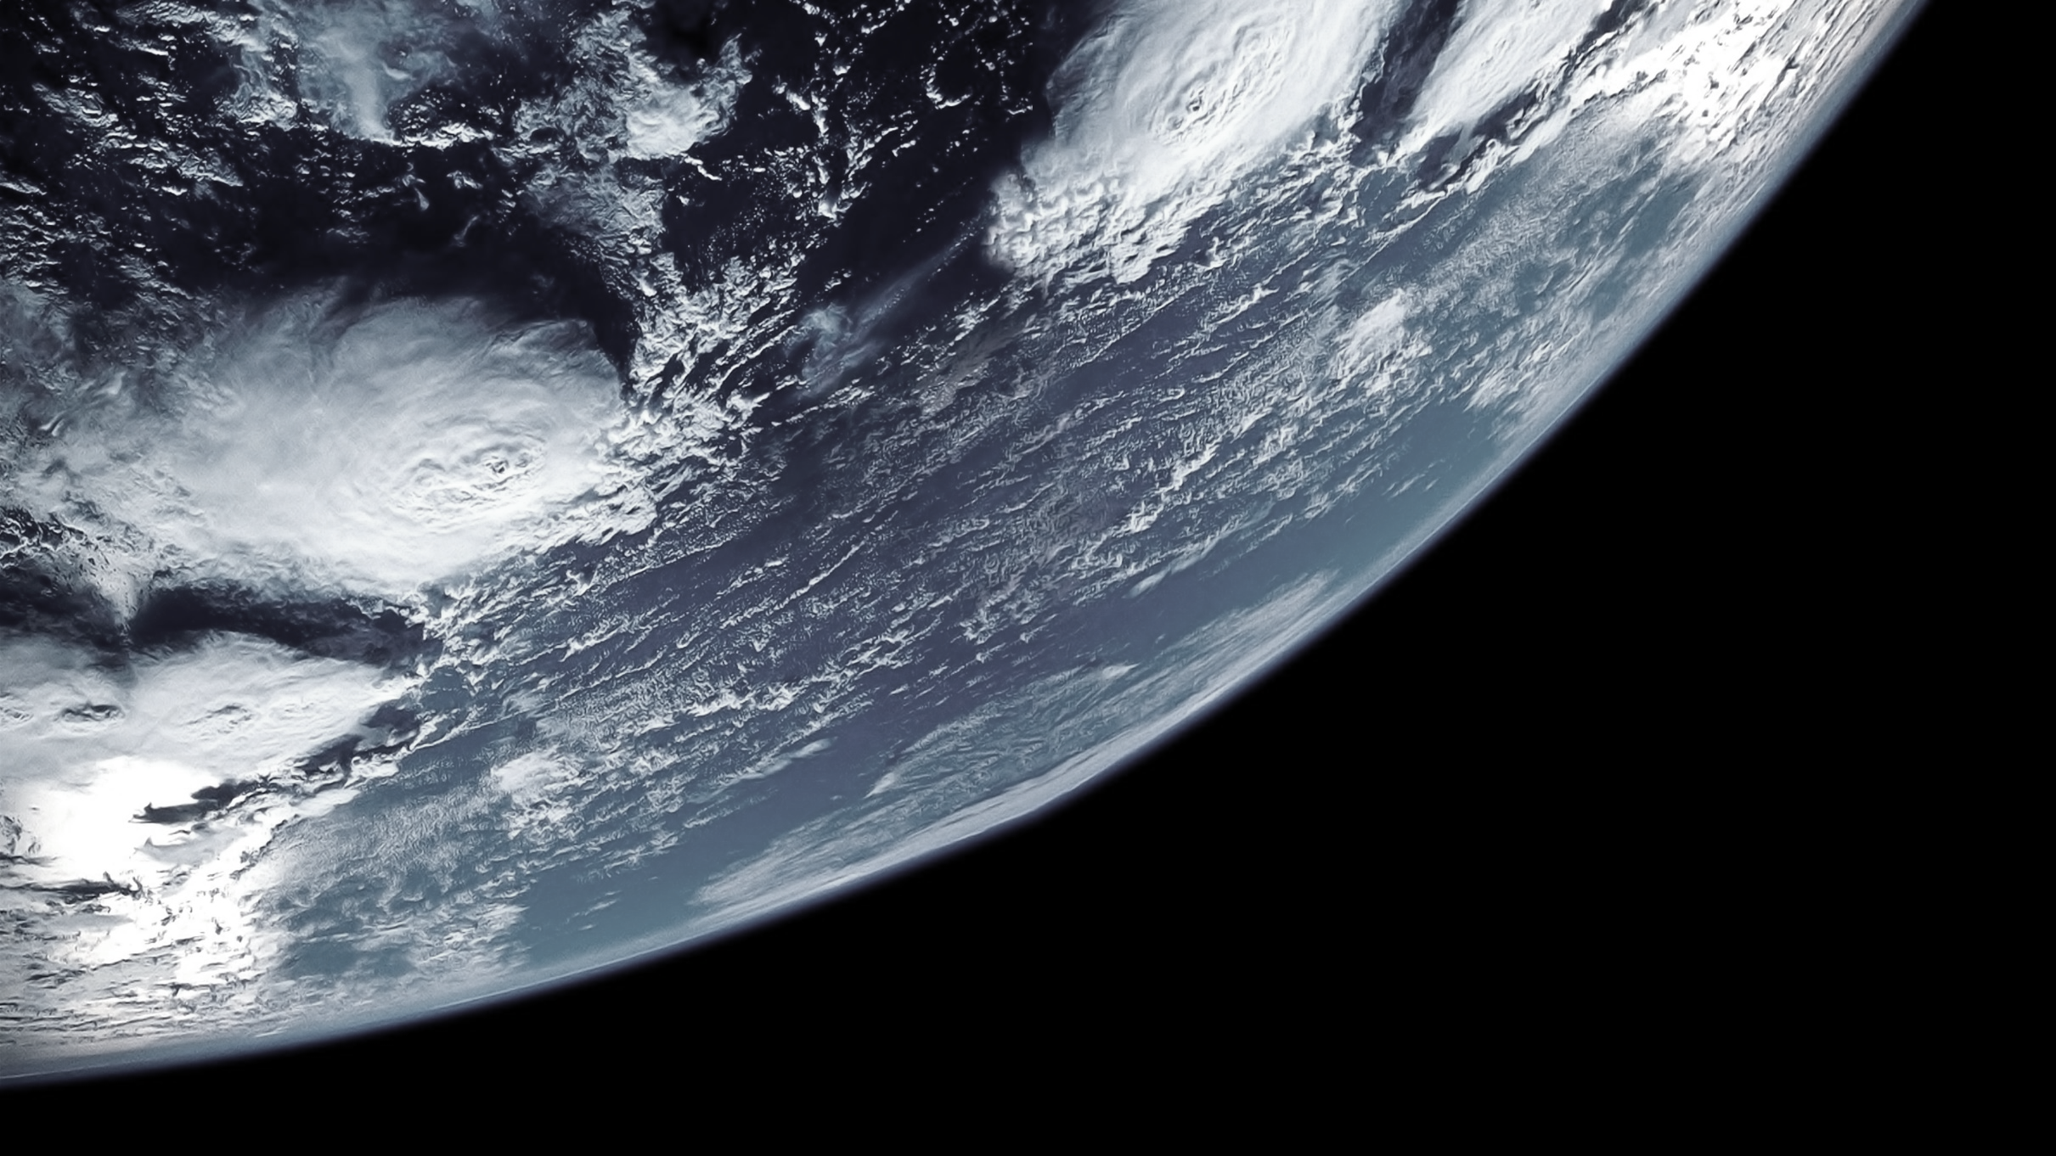
THE DAY OF SPACE FLIGHTS
By Emiliano Romero Ruiz

Slide 2
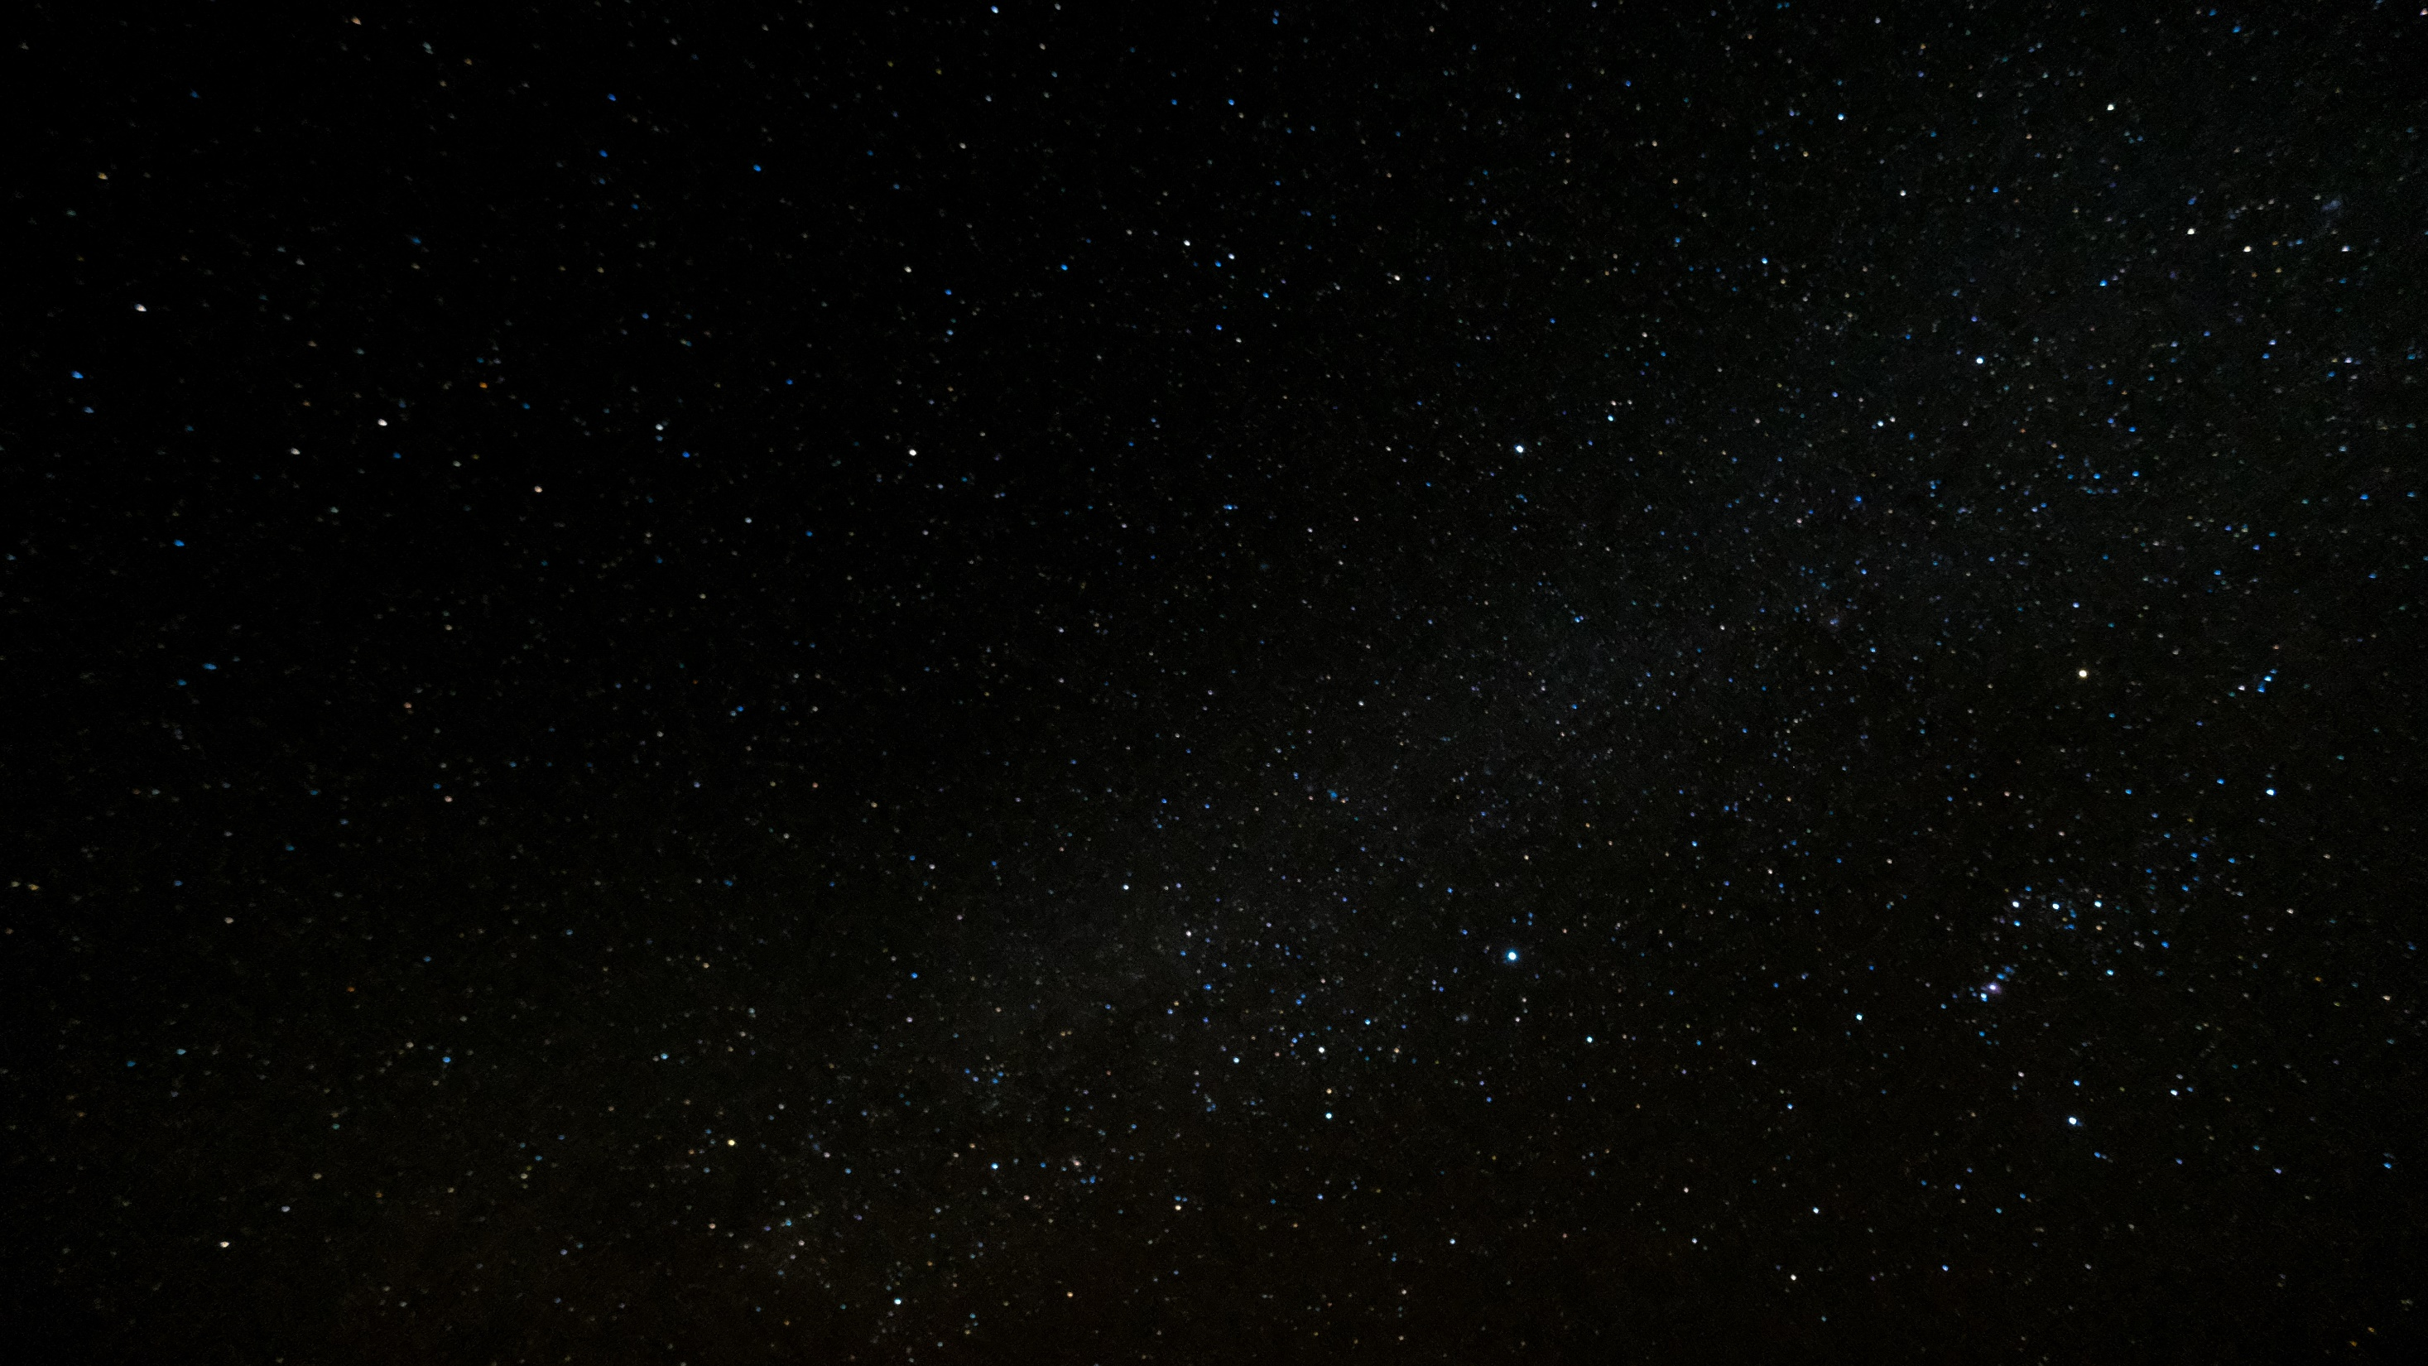
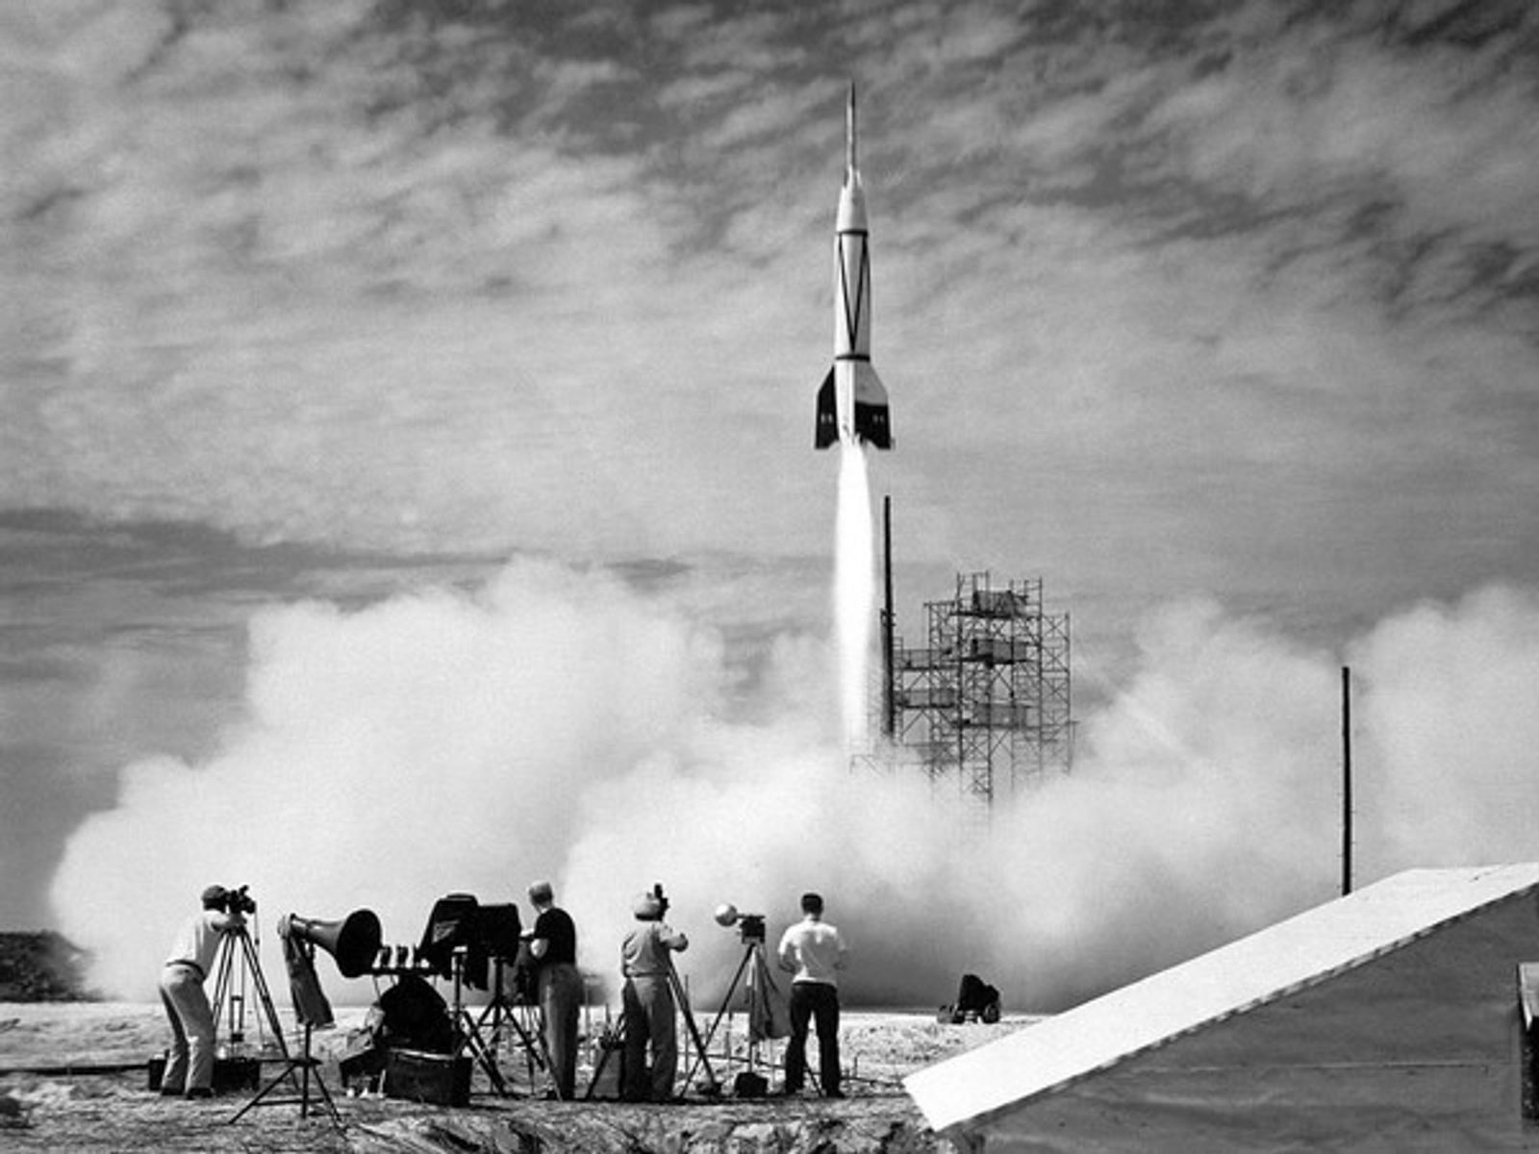
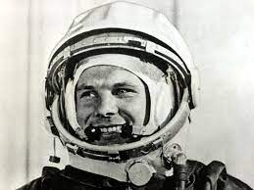
International Day of Manned Space Flights
¡Today April 13, 2023 we celebrate the International Day of Manned Space Flight!
This day is very important, because the space flights helped us to advance in knowledge about space, which we know only a small part of it, which is our Solar System.
A day like today in the year 1961 a Russian citizen, Yuri Gagarin, made the first space flight in the history.

